Slide 1


Immigration Status & Social Assistance
Insert clinic name
Date
Notes:
You can add your clinic logo here. You can also remove or keep the CLEO Connect logo as you customize your training
Introduce yourself, your legal clinic, your catchment area, and any other relevant information
Ask participants to introduce themselves (depending on the number of participants)
Invite participants to say or ‘chat’ one thing that they hope to learn from the session
Depending on your audience, you might also want to say that:
There are 73 legal clinics in Ontario.
60 have geographic catchments throughout Ontario.
13 provide services to specific populations — for example: Aboriginal Legal Services (ALS); Black Legal Action Centre (BLAC); Centre for Spanish-Speaking Peoples (CSSP); Chinese & Southeast Asian Legal Clinic (CSALC); and the South Asian Legal Clinic of Ontario (SALCO).
The Income Security Advocacy Centre (ISAC) has great Public Legal Education resources and engages in strategic litigation in social assistance.

Slide 2
Agenda
1. Welcome and introductory activity
2. How immigration status affects eligibility for social
  assistance
3. Eligibility scenario for discussion
4. Barriers to social assistance
BREAK
5. How social assistance affects immigration applications
6. Sponsorship scenarios for discussion
7. What can community workers do? Resources for clients
8. Evaluation and Wrap-up
Notes:
Say that you will aim to follow this agenda, and that you are open to questions and some discussion as you go through the material.
Let participants know there will be a break.
Discuss the role of community workers in providing helpful information and in steering someone to further help.
Inform participants that the aim of the training is NOT for them to become experts in social assistance or immigration law, but rather to increase their understanding, and to become familiar with helpful resources they can share.

Slide 3






Creating Safer Spaces
Right to Pass
Q and A
Polling and whiteboard
Reminder — mute mic when not sharing
Remember folks on the phone
Chat and private message functions
Notes:
Explain technical details related to the format of the training (for example: muting microphones, polling features, creating a virtual background, etc.)
Emphasize the goal to create an anti-oppressive environment. Briefly discuss: the right to pass (participants don’t have to answer a question or make a contribution if they don’t want to); confidentiality (what is learned, leaves, and what is shared, stays); and respect for each other.
Explain whether you like to have questions raised as you go along or at specific times, and when the break will be.
Explain that you want to encourage thought and discussion, that this content may be NEW to some participants, and that all questions are welcome.

Slide 4
Land Acknowledgment
[Add a meaningful land acknowledgment connected to where you are delivering the workshop]
Notes:
Take time to pause and acknowledge the current occupation of Indigenous land and territory by settlers in Canada and our treaty responsibilities.
Work with folks in your communities to develop a land acknowledgment that speaks to colonialism and how it connects to your work. Consult Indigenous partners in your region. You may wish to include examples of active allyship.

Slide 5

Activity — Myth Busting
I can only get Ontario Works (OW) if I was born in Canada.
Notes:
Immigration Status & Social Assistance — MYTH BUSTING ACTIVITY
There are 4 statements in this activity. Choose as many as you have time for.
Pose each statement and get participants to choose TRUE or FALSE.
Discuss misinformation or assumptions that many people have about social assistance and immigration status.
Ask the group if they are surprised by any of the answers. Say that you’ve included another slide with the correct answers.
Use the discussion to ask participants to share any questions that they hope will be addressed in the workshop.
In-person instructions: Use a simple show of hands or have participants share their answers.
Online instructions: Create a TRUE/FALSE poll to pose each statement (one at a time) and ask participants to choose TRUE or FALSE. Or ask them to raise a digital hand or use the chat feature to type their response.
Answer for this slide: FALSE
You don’t have to be a Canadian citizen to receive OW, social assistance. You also don’t need to have permanent status in Canada.

Slide 6

Activity — Myth Busting
Receiving OW will affect the outcome of my refugee claim.
Notes:
MYTH BUSTING ACTIVITY — see instructions in notes at slide 5.
Answer for this slide: FALSE
Refugee claimants are entitled to OW. There is no impact on how their refugee claim is decided if they receive social assistance.

Slide 7

Activity — Myth Busting
I can sponsor my spouse if I receive benefits from the Ontario Disability Support Program (ODSP).
Notes:
MYTH BUSTING ACTIVITY — see instructions in notes at slide 5.
Answer for this slide: TRUE
Receiving social assistance for reason of disability does not affect your right to sponsor a spouse. Generally speaking, you can’t sponsor them if you receive OW, but it is possible to ask for an exemption, legal advice is needed.

Slide 8
Activity — Myth Busting
If I leave my sponsor, I can apply for
OW.
Notes:
MYTH BUSTING ACTIVITY — see instructions in notes at slide 5.
Answer for this slide: MAYBE
This question is a little more complicated. As we will discuss later in this session, the answer depends on whether the sponsor is still obligated to support their
spouse under the contract, or undertaking, that they signed with IRCC — Immigration, Refugees and Citizenship Canada.

Slide 9
Myth Busting Answers
1. I can only get OW if I was born in Canada. FALSE
2. Receiving OW will affect the outcome of my refugee
claim. FALSE
3. I can sponsor my spouse if I receive ODSP. TRUE
4. If I leave my sponsor, I can apply for OW. MAYBE
Notes:
ANSWERS — MYTH BUSTING ACTIVITY
This activity attempts to dispel some of the commonly held beliefs about entitlement to social assistance and the impact receiving social assistance can have on immigration sponsorships. We will discuss them in more detail in this presentation.

Slide 10
Learning Goals
1. How does immigration status affect eligibility for social assistance (OW and ODSP)?
2. How does receiving social assistance affect immigration applications?
3. What can community workers do to help clients who have been denied assistance?
Notes:
Inform participants that the aim of the training is NOT for them to become experts in social assistance or immigration law, but rather to increase their understanding about eligibility and consequences, and to become familiar with helpful tips and resources they can share to help their clients.
Let participants know you will be sharing the slides later — there are many useful resources listed in the slides at the end of the presentation.

Slide 11
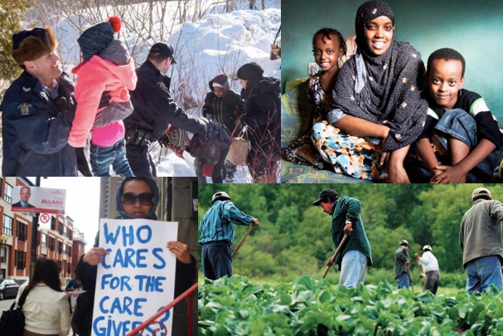
Systemic Barriers & Lived Reality
Notes:
Tell participants that the point of this slide is to keep in mind the many barriers that exist for refugees, live-in caregivers, migrant workers and undocumented
people in Ontario. Fears about precarious status, language barriers and lack of information and resources compound disadvantage, not to mention the real fear that OW/ODSP workers will share their information with CBSA.
People are living in “deep poverty” — inadequate $733 per month for basic needs and shelter for one person on Ontario Works and $1, 308 for someone living
with a disability in Ontario.
Many of you are well aware of the exploitive dynamics in work and intimate relationships that can result in a need for financial assistance.
Sometimes barriers come from within social assistance institutions themselves — this presentation aims to address the misunderstandings, negativity, and
reluctance — to accept applications and reluctance to push to apply and request a decision.

Slide 12
How immigration status affects eligibility for social assistance
Notes:
Optional slide/information to share if participants want more detail about the authority under the OW and ODSP Regulations regarding Status in Canada that this workshop covers.
Note: it is s.6 under OW Reg. https://www.ontario.ca/laws/regulation/980134#BK6 and s.8 under ODSP Reg. https://www.ontario.ca/laws/regulation/980222#BK8
Status in the Country
(1) The following persons are not eligible for assistance:
1. Subject to subsection (2), a person,
i. against whom a deportation order has been made under the Immigration Act (Canada), or with respect to whom a departure order or an exclusion order under that Act has become effective, or
ii. with respect to whom a removal order has become enforceable under the Immigration and Refugee Protection Act (Canada).
2. Subject to subsection (3), a person who is a visitor, unless the person,
i. has made a claim for refugee status under the Immigration Act (Canada),
ii. has made a claim for refugee protection under the Immigration and Refugee Protection Act (Canada), or
iii. has made an application for status as a permanent resident under the Immigration Act (Canada) or the Immigration and Refugee Protection Act (Canada).
3. A person who is a tourist. O. Reg. 134/98, s. 6 (1); O. Reg. 395/04, s. 2 (1); O. Reg. 303/22, s. 1 (1).
(2) Paragraph 1 of subsection (1) does not apply with respect to a person if the administrator is satisfied that,
(a) for reasons wholly beyond the control of the person, the person is unable to leave the country; or
(b) the person has made an application for status as a permanent resident on the basis of humanitarian or compassionate considerations, as referred to in subsection 114 (2) of the Immigration Act (Canada) or subsection 25 (1) of the Immigration and Refugee Protection Act (Canada). O. Reg. 134/98, s. 6 (2); O. Reg. 395/04, s. 2 (2).
(3) Paragraph 2 of subsection (1) does not apply with respect to a person for the purposes of determining eligibility for emergency assistance if that person has been granted an emergency authorization to enter into and remain in Canada for humanitarian reasons, for the duration of that authorization or any subsequent authorizations issued for the same purpose. O. Reg. 303/22, s. 1 (2).

Slide 13

Who is a citizen?
Born in Canada
Naturalized
a minor whose parent/guardian has applied for them
Notes:
There are a few ways you can become a Canadian citizen, for example:
You are likely a citizen if you were born in Canada;
You applied to become a citizen such as a naturalized citizen who became a citizen after arrival in Canada — they are born outside Canada;
You received Canadian citizenship as a minor when a parent or legal guardian applied for your citizenship.

Slide 14
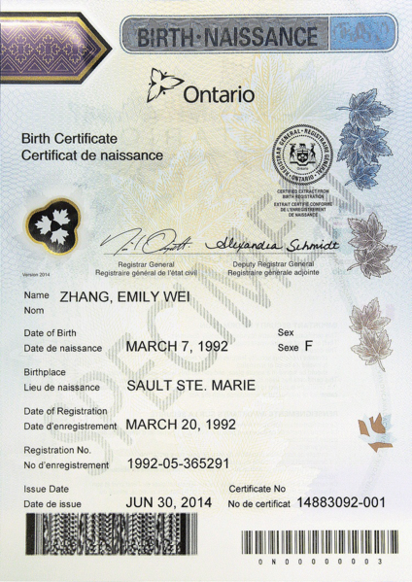
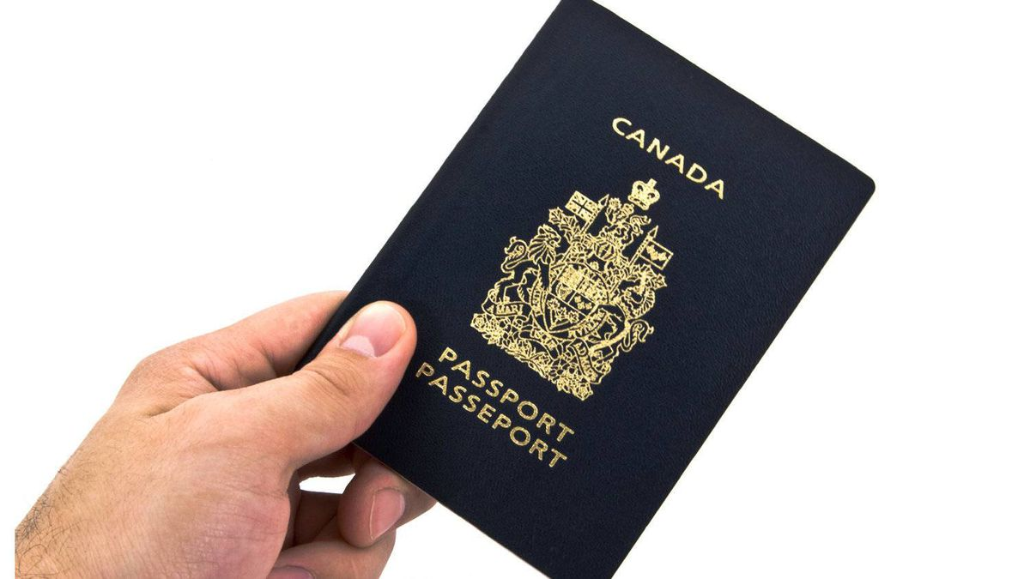
How does Social Assistance (SA) treat citizens?
Citizens are eligible for Social Assistance (must meet other eligibility criteria)*
To prove citizenship, use:
Passport
Birth Certificate
Citizenship card/certificate
*Social assistance eligibility criteria include
income, assets, family unit and residence
Notes:
Citizens are eligible for social assistance
Of course, even when someone’s immigration status is not a bar to social assistance eligibility, there are still other eligibility criteria
These include the person’s income, assets, family unit and where they live

Slide 15
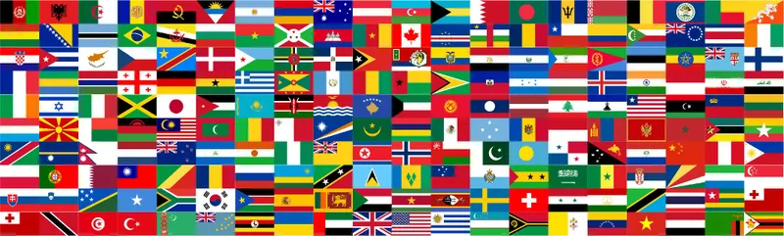
Who is a Permanent Resident (PR)?
Someone given “permanent” status in Canada who is a citizen of another country
PR status has not been taken away
Notes:
There are many ways to obtain Permanent Resident (PR) status — the federal government department, Immigration, Refugees and Citizenship Canada (IRCC) processes many types of applications for PR status.
A few examples: a spousal sponsorship, application for Permanent Residence after acceptance as a Convention refugee.
Permanent Resident status is not exactly what it claims to be — it is possible to lose the status (therefore, it’s not “permanent”) as a result of a criminal conviction, if someone is outside Canada for too long (called the residency obligation), or they misrepresented (lied) on their application. These concepts and consequences are beyond the scope of this presentation, but the take-home point is that PR status is not exactly what it claims to be.
It is also referred to as ‘landed immigrant’ status.

Slide 16
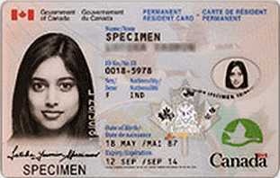
How does SA treat permanent residents?
Permanent residents are eligible for Social Assistance (must meet other eligibility criteria)*
To prove your PR status, use:
PR Card
Record of landing
Confirmation of PR letter
*Social assistance eligibility criteria include income, assets, family unit and residence
Notes:
Like citizens, permanent residents are eligible for social assistance as long as they meet all of the other eligibility criteria

Slide 17
Who is a permanent resident applicant?
Submitted an application to IRCC to become a PR
Some examples include:
spousal sponsorship from within Canada
successful refugee claimant/protected person
Humanitarian and Compassionate Grounds Application (H & C)
Notes:
There are applications for PR made inside and outside of Canada — we are talking about inside Canada applications in this presentation — sponsorship of a spouse or common-law partner — someone who has been accepted as a refugee in Canada, and there is also an application for PR based on Humanitarian and Compassionate (H & C) considerations, which is important to know about. Tell them you will explain that more in the next slide.

Slide 18

What is an H & C application?
Application for PR made to IRCC from inside Canada based on humanitarian and compassionate reasons
It is discretionary
There is no stay of removal while waiting
Factors include Hardship and Establishment
Best interests of the child/children
Increased visibility. Social assistance often seen as decreasing “establishment”.
Notes:
The H & C application is an application for PR status made within Canada that asks for an exception to the rule that people must apply for PR from outside Canada. It can also request exemption from any requirement of the Act.
H & C applications are discretionary.
They can take up to 3 years to get a decision.
There are 2 main considerations — establishment and hardship — is the person established in Canada and what hardship will they (or their family members) experience if they have to apply from outside Canada.
Another important factor is the best interest of a child/children who is/are affected by the outcome of the decision.
No statutory stay — means applicants can be removed while waiting for an answer.
Cautionary notes re H & Cs:
Increased visibility once you apply — IRCC and Canada Border Services Agency (CBSA) know the applicant’s address and receiving social assistance is seen as a negative factor — it takes away from the “establishment” factor since the applicant is relying on government for support. BUT receiving social assistance is not always fatal, has been overcome in situations of family violence and other vulnerable applicants (medical or mental health issues).
Note: A person receiving Ontario Disability Support Program (ODSP) is not a negative factor, since it’s based on a disability. Really, the success of H & C applications depends on the unique facts of each situation.

Slide 19
How does SA treat PR applicants?
PR applicants ARE eligible for Social Assistance, as long as they meet other eligibility criteria*
To prove you are an H & C applicant, use:
  Copy of cover letter
  IRCC acknowledgment of receipt
  Proof of payment of $550 or total fee for family
  Letter from lawyer
*Social assistance eligibility criteria include income, assets, family unit and residence
Notes:
PR applicants, which are often applicants on the basis of humanitarian and compassionate grounds, are eligible for social assistance
This is a bit of an odd category since people who have applied for PR do not necessarily have stable status in Canada
We will talk about the impact of receiving social assistance on PR applications in the second half of the presentation, including sponsorships
Recently OW offices have circulated a policy that H & C applicants have to show the “Acknowledgement of receipt” from IRCC which can take some time to receive. This does not mean you have to wait to apply. It is another hurdle for already vulnerable people and can be challenged by showing proof of when the application was made, while waiting for the acknowledgement letter. Also, retroactive benefits after a successful appeal will be calculated using the application date.

Slide 20

Who is a refugee claimant?
  Made a refugee claim in Canada and is:
  Waiting for their hearing or a decision on claim
  Appealing to the Refugee Appeal Division (RAD)
  Applying to the Federal Court to review negative decision
Notes:
A refugee claimant is someone who has fled their country and is asking for protection in Canada.
Someone is considered a refugee claimant if they have made a claim in Canada, are waiting for their hearing, waiting for a decision after their hearing, or if they are appealing a negative decision to the Refugee Appeal Division (RAD) or if they have applied to Federal Court for a Judicial Review (JR) of a negative refugee decision.

Slide 21
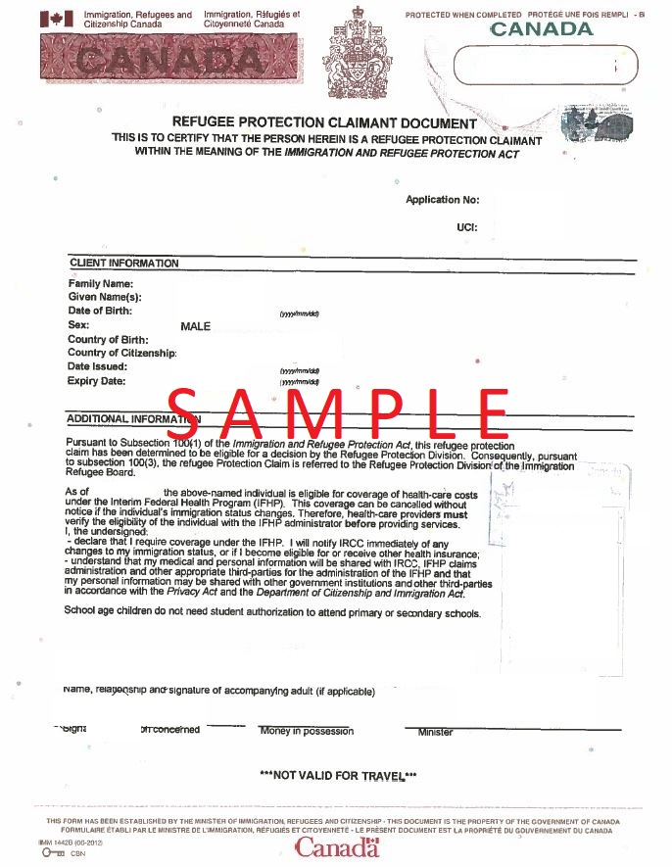
How does SA treat refugee claimants?
Refugee claimants ARE eligible for Social Assistance, as long as they meet other eligibility criteria*
To prove you are a claimant, use:
Refugee protection claimant document
Notice of hearing
Notice of appeal
*Social assistance eligibility criteria include income, assets, family unit and residence
Notes:
Refugee claimants are eligible for social assistance — this is before there is a decision on their claim.
It used to be that refugee claimants could only receive emergency assistance that had to be renewed regularly — now refugee claimants are eligible for regular assistance
Caseworkers will often ask for status updates from refugee claimants, as well as PR applicants, on a regular basis

Slide 22
Who is a protected person?
  Made a refugee claim or submitted a Pre-Removal Risk Assessment (PRRA) in Canada that was accepted.
  Convention refugee
  Person in need of protection
Notes:
A protected person is someone whose claim for protection was accepted.
A protected person is someone who is considered a Convention refugee or a Person in need of protection.
This status is obtained at the Refugee Board or in a different process called a Pre Removal Risk Assessment, usually a written application.

Slide 23
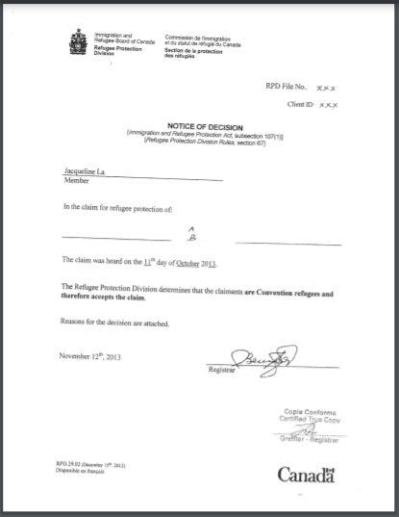
How does SA treat protected persons?
Protected Persons ARE eligible for Social Assistance,
as long as they meet other eligibility criteria*
To prove you are a Convention refugee/
person in need of protection, use:
Notice of positive decision from RPD or
RAD confirming status
Notice of positive PRRA decision
*Social assistance eligibility criteria include income, assets, family unit and residence
Notes:
Protected persons are eligible for social assistance
NOTE: Clients only have to provide the notice of decision page, not the written reasons that include details of their claim (protect their privacy)

Slide 24
How does SA treat PRRA applicants?
Pre-Removal Risk Assessment (PRRA) Applicants ARE eligible for Social Assistance as long as they meet other eligibility criteria*
To prove you are a PRRA applicant, use:
  document confirming served with PRRA,
  proof of ineligibility to make a refugee claim,
  notice to appear for PRRA hearing,
  letter from lawyer
*Social assistance eligibility criteria include income, assets, family unit and residence
Notes:
PRRA applicants can be a failed refugee claimant or someone who was not eligible to make a refugee claim, but they can make a PRRA since the risk they face on removal hasn’t been considered
PRRA applicants are seeking protection, so they are treated similarly to a “refugee claimant”
Today we won’t go into specifics about the process for making applications like a PRRA — we are just looking at if people with various statuses and applications are eligible for social assistance

Slide 25
Who is a person without immigration status?
A student, visitor or worker whose status expired
A refused refugee who did not leave Canada
Stateless person
Sponsorship breakdown before becoming PR
Someone who entered Canada between two border points/ports of entry (POE) who has not made a refugee claim
Notes:
There are many reasons why someone might not have regular status in Canada. This list is not exhaustive. They may have status at one point that expired, or they may have failed to do something, like show up for removal. There may be a warrant for their arrest, or immigration authorities may not know that they are in Canada.

Slide 26
What is a removal order?
Departure order: Must leave within 30 days
Exclusion order: Must leave and can’t return for a certain period of time without permission
Deportation order: Must leave and can’t return without permission
Notes:
Explain that the social assistance system is focused on whether the person applying for benefits can be removed from Canada. The question they ask is — is their removal order “enforceable”. There are 3 types of removal orders that someone without permanent status can have.

Slide 27
Can all removal orders be enforced?
NO!
You can’t be removed:
  During certain processes (refugee claims, some appeals/judicial reviews)
  To certain countries that are unsafe (temporary suspension of removal list, administrative deferral of removal list)
  If Canada Border Services Agency (CBSA) agrees to ‘defer’ the removal
  If a Federal Court judge orders a stay of removal
Notes:
The question of whether the removal order can be enforced is important and a little complicated.
There are some important points to consider.
First is called a statutory stay — the law protects people from removal when they are in the middle of some processes/applications, not others
We include the link to the list of the countries that IRCC does not remove people to at the end of these slides
Afghanistan, Democratic Republic of Congo, Iraq — called TSR (temporary suspension of removal) countries, and ADR list
A request to defer (postpone or delay) a removal is a discretionary decision made by Canada Border Services Agency (CBSA) — it’s not easy to get
And sometimes the Federal Court orders a stay of someone’s removal — this is called judicial stay of removal
People who are waiting for a criminal trial also can’t be removed — get letter from criminal lawyer to prove this. Someone who has been charged with a crime can’t be removed while they wait for their criminal trial — get letter from criminal lawyer to prove this.

Slide 28
How does SA treat undocumented people and those w/ Removal Orders?
Not eligible for social assistance unless:
  Removal order can’t be enforced, or
  Made an H & C application, or
  Can’t leave for reasons “beyond their control”
  To prove you can’t be removed, use:
  Proof of nationality from Administrative Deferral of Removal (ADR) or Temporary Suspension of Removal (TSR) country,
  Canada Border Services Agency (CBSA) deferral of removal letter
  Letter from lawyer
Notes:
You are eligible for social assistance as an undocumented person as long as you are not a visitor. As discussed earlier, this is a controversial term. A person might be denied OW by a local office for being a “visitor” even if they are undocumented. The Tribunal might agree that they are not a visitor so it may be worth doing an appeal.
People who are subject to removal orders are not eligible for social assistance
BUT there are three exceptions, so you need to ask more questions
(1) Is the removal order enforceable?
(2) Did the person make an H & C application?
(3) Can the person leave Canada, or do they have to stay for reasons beyond their control? This can include people who CBSA is having difficulty getting a travel document from their country.
Here are examples of documents you can share to show that you can’t be removed. The letter from their lawyer can explain if there is a statutory, judicial or other stay in place so they can’t be removed.
Share with participants this link to the CBSA webpage that connects to the list of ADR and TSR countries: https://www.cbsa-asfc.gc.ca/security-securite/rem-ren-eng.html
Tell them that clients can print this list and include it with proof of their nationality.

Slide 29
Reasons “beyond their control”
  People might be unable to leave Canada for various reasons, including if they:
  Don’t have travel or identity documents
  Have pending criminal charges
  Are in hospital or there is a medical reason that prevents them from leaving
Notes:
So, concerning the 3rd question from the previous slide,
(3) Can the person leave Canada, or do they have to stay for reasons beyond their control? This can include people who CBSA is having difficulty getting a travel document from their country.
Here are examples of situations where a person may not be able to be removed that are ‘beyond their control’.

Slide 30
Who is a Temporary Resident Permit Holder?
Someone who applied for and received a Temporary Resident Permit (TRP)
Purpose
Eligibility
Validity: 1 day to 3 years, but may be cancelled at any time
Notes:
A TRP used to be called a Minister's Permit — a discretionary tool to get around, or overcome, an inadmissibility — for example, medical or criminal factors, or inadmissible because of previous immigration enforcement action.
It is a document issued by IRCC that allows people who are technically inadmissible to Canada to visit the country or stay temporarily.
Example of a TRP holder: victims of human trafficking, survivor of family violence, vulnerable worker category
A TRP should not be confused with a temporary resident visa (TRV). A TRV is a document issued to visitors, students and workers. It is usually placed in their passport and can be used to travel to Canada.
TRP holders, visitors, international students, foreign workers have temporary status in Canada. Under immigration law, people with temporary status or no status in Canada are also referred to as foreign nationals.
Side note: Maintained status in Canada, previously called “implied status”, is when a worker, visitor, or student applies to extend or change their temporary status in Canada before that status expires, and are waiting for a decision. It is also possible to apply to RESTORE expired status within 90 days.

Slide 31
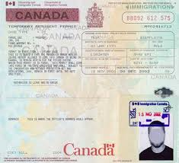
How does SA treat Temporary Resident Permit Holders?
TRP holders MAY BE eligible for Social Assistance as long as they meet other eligibility criteria*
Use to prove you are a
TRP holder:
A copy of your TRP
Letter from lawyer
*Social assistance eligibility criteria include income, assets, family unit and residence
Notes:
TRP holders may be eligible for social assistance
Sometimes caseworkers will not understand what a TRP is or how it may entitle an individual to social assistance. This is an unsettled point and depends on the context, which is beyond the scope of this presentation

Slide 32
Who is a Visitor?
Dictionary definitions:
Visitor /’viz.i.ter/ — A person who visits a person or place.
Visit /’viz.it/ — to go to a place to look at it, or to go to see and spend time with a person.
Notes:
A recent Social Benefits Tribunal decision says that a visitor for the purposes of social assistance is not defined by immigration law, or by the Ministry’s policy, but by the “ordinary usage of that word”, referencing people who visit Canada
OW is not available to people who are visiting Canada, as opposed to people who have established a residence here, whether or not it is authorized by the government

Slide 33
Am I a “visitor”?
According to… | Visitor | Worker/ Student | Person without status
Immigration, Refugees Citizenship Canada | YES | NO | NO
Social Assistance Ministry | YES | YES | YES
Social Assistance Offices | YES | YES | YES
Social Benefits Tribunal | YES | MAYBE | MAYBE
Notes:
Definition of who is a “visitor” can be confusing
In immigration law, it is someone who has been authorized to stay in Canada as a visitor. It’s one type of temporary resident status (it is not a TRP). Other temporary residents can be workers and students. They are not considered visitors in immigration law.
Visitor is not defined in social assistance law. The Ministry has created its own policy directive that defines visitor. This does not mean that it is correct; it is simply the Ministry’s interpretation of who a visitor can be, and it is much wider than immigration law.
The Policy Directive says that visitors are people who are in Canada for a temporary purpose. This includes people who have a “tourist visa” (even though that’s not possible under immigration law), student visas and work permits. The social assistance Ministry also includes people who may be temporarily re-located from another country (e.g., a natural disaster has forced a community evacuation) under the category of visitor.
Social Assistance offices tend to see anyone without one of the statuses we’ve already covered as being a visitor. They cast a much wider net.
For this reason, it is important to make sure you ask for a written decision for a refusal of an application, or push to complete an application even if the staff say your client isn’t eligible. And, of course, referral to the client’s local community legal clinic for legal advice and help.

Slide 34

Who is a Tourist?
  Not defined in the law
Dictionary /‘tur.ist/: one that takes a tour for pleasure or culture.
Social assistance policies define tourist as a person “in Canada for a short period of time.”
Notes:
Tourists are also not defined in the law, and tend to be lumped in with visitors when social assistance officials make decisions
Presumably the term can also be understood within the ordinary meaning of the word

Slide 35
How does SA treat visitors and tourists?
NOT eligible for social assistance, unless:
  Made a refugee claim
  Made a Permanent Resident (H & C) application
  Can’t be removed from Canada
Notes:
Visitors and tourists means people who are visiting and touring Canada within the ordinary meaning of those terms, and people who have not established a residence here. They are not eligible for social assistance unless they have made a refugee claim, a permanent resident application (H & C) or they cannot be removed from Canada

Slide 36
Scenario 1: Ilana
Ilana arrived in Canada as a visitor two years ago. She left her country of origin because she was afraid of an ex-boyfriend and the police. She realized that it wasn’t safe to return home.
She had a son in Canada. She received healthcare for her and her baby. She developed friendships.
She tried to apply for refugee status but the process was confusing. She recently retained a lawyer but has not filed a refugee claim yet.
Is Ilana eligible for Ontario Works benefits?
Notes:
Read the scenario to participants. Pose a poll question whether Ilana is eligible in the chat — YES or NO

Slide 37
Scenario 1: Ilana
YES. Ilana is not a visitor.
The Ministry policy and local Ontario Works office say that Ilana is NOT eligible for Ontario Works.
The Social Benefits Tribunal says that Illana IS eligible for Ontario Works based on the plain language meaning of “visitor”. The Tribunal overrules the Ministry and local office.
Notes:
Ilana is NOT a visitor so she should NOT be excluded from Ontario Works eligibility
She IS eligible for Ontario Works as long as she meets the other eligibility criteria like income and assets
These are some of the facts from the case referred to earlier. The Tribunal defined visitor by its ordinary meaning (SBT File No: 1907-05378)
The Tribunal found that: “The Appellant’s circumstances including the duration of her stay, her integration into the community, along with other hallmarks of permanency are inconsistent with and not indicative of someone who is a “visitor”. That term’s common and regular usage denotes a less formalized and more temporary connection.”
The Tribunal considered factors such as:
Shortly after arriving as a visitor, she decided to stay in Canada due to fear of returning home
She began a relationship
That relationship ended, but afterward she found out she was pregnant
She had a complicated pregnancy that saw her move to another city due to her support and healthcare needs
She found housing
She developed friendships, a supportive network, and engaged with healthcare
Early on and over the course of her stay in Canada, she sought legal advice on how to make a refugee claim, but this took time
She eventually did submit her refugee claim

Slide 38
In summary…
The only people NOT eligible for Social Assistance:
Those with enforceable removal orders who haven’t applied for PR based on H & C grounds who can leave the country.
Visitors who have not made a refugee claim or a PR application.
Tourists.
Notes:
Social assistance legislation in Ontario is framed in the negative (who cannot get social assistance vs who can)
Ministry policies can also be confusing because they don’t necessarily properly reflect the law
Social assistance caseworkers, and by extension the Tribunal, are bound by the law — NOT the Ministry’s policies
Putting that all together, the only people who are NOT eligible for social assistance are:
(1) Those with enforceable removal orders who have not applied for PR based on H & C grounds and who can leave the country
(2) Visitors who have not made a refugee claim or a PR application
(3) Tourists

Slide 39
Immigration Status | Eligibility for SA?
Citizen | Yes
PR | Yes
Refugee claimant | Yes
Protected Person | Yes
H & C applicant | Yes
Temporary Resident Permit holder | Maybe
Visitor | See ‘Am I a Visitor’ Chart
Undocumented person | See ‘Am I a Visitor’ Chart
Notes:
This slide summarizes the previous section. There is a new online application system for Social Assistance that is being used in some regions. It deems someone with TRP status ineligible and will not complete their application. The online system also has a status category of “deportee” which is not very helpful, as we have discussed, people may have a removal order against them that cannot be enforced for various reasons.
If your client cannot complete their application through this online system, they can call the Social Assistance office to complete it by phone. They should be referred to their local legal clinic for help.

Slide 40

Framing Eligibility
Any ambiguity should favour the applicant
Show they are NOT ineligible
Notes:
A basic principle of understanding social assistance laws is that any ambiguity should be resolved in favour of the applicant or recipient — this is because social assistance is a welfare program meant to help people
That means that if it can be understood that someone is eligible for social assistance, they ought to be eligible
The key is to prove that the applicant is not a tourist, not a visitor and is not subject to enforceable removal order
If all of those things are true, then the applicant IS ELIGIBLE FOR SOCIAL ASSISTANCE

Slide 41
Barriers to Social Assistance
At social assistance offices:
  Staff discourage applicants
  Misinterpretation of eligibility
From service providers:
  Transient clients
  Geographic boundaries
  Appealing decisions
Notes:
Unfortunately, it’s not only being a visitor, tourist or subject to an enforceable deportation order that stops people from receiving social assistance
People with precarious immigration statuses face numerous additional barriers
Staff at social assistance offices have been known to discourage people from even completing their applications — so they never get decision letters that explain how to challenge decisions
Sometimes, people with precarious immigration status are worried about being found and removed so they will take the word of the government official telling them they are not eligible without challenging it
Even when they do take applications, local offices are likely to rely on the Ministry’s policies rather than the reading and interpreting the law
This means that many people might be rejected as visitors even if they are NOT
There are also barriers from service providers — sometimes clients who are transient don’t fit well into our geographical boundaries, are afraid to reach out for help, or don’t do well with formal means of communication.
We try to be flexible with clients, meet them where they are, and use communication tools that they are comfortable with.

Slide 42
What to do if an application is denied?
Have you applied for social assistance?
No, I was told I’m not eligible.
Yes.
You have the right to apply AND get a written decision.
Was application accepted?
After you apply, ask the worker for a letter that explains
their decision.
Yes. I am receiving social assistance.
No. It was denied.
You have 30 days to write letter asking for an internal review.
Notes:
Everyone who applies for social assistance is entitled to a decision! — even if the intake worker says that they are not eligible, they should push through the process and complete the applications
Applicants who are denied social assistance should seek legal advice on their next steps
They may be able to request an internal review and then appeal
Temporary benefits, called interim assistance, might be available to people right after they file their appeal. It pays social assistance benefits until the case finishes. If the person is unsuccessful with the appeal, then they have to pay it back. But if they are successful then they get to keep the money.
Interim assistance is often a way for people to survive while they sort out their social assistance eligibility and work towards regularizing their immigration status
If a client is in this type of situation (or if you think the worker won’t understand a client’ status and eligibility), it is a good idea to refer them to a legal clinic who can intervene either with a letter of explanation to accompany their application or to bolster the request for internal review if they are denied.

Slide 43
What can community workers do?
Encourage those in financial need to apply for social assistance regardless of their immigration status*
Help clients insist on completing social assistance applications even if they are told verbally that they are not eligible for benefits
Warmly refer clients to their local legal clinics, who can assess eligibility, file internal review requests, file appeals, and request interim assistance
*If the person has an immigration lawyer, talk to that person first.
Notes:
Community workers can provide support to clients from the background, and even intervene if clients aren’t able to push through social assistance applications on their own
Always remember that legal clinics are available to help, particularly with formal legal steps like filing internal review requests and appeals!

Slide 44
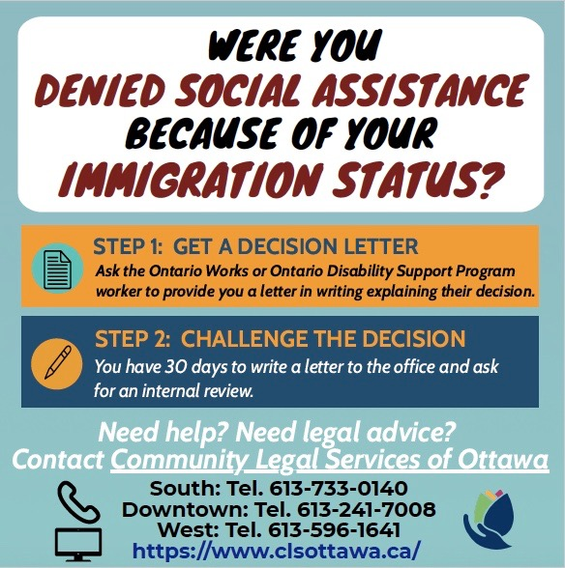
Notes:
Practices from Community Legal Services in Ottawa (Sharing experiences: direct outreach).

Slide 45

Questions?
Notes:
(This slide will be up on the screen while the Q & A sessions are going on.)
10 minutes

Slide 46

Time for a break
Notes:
Consider a 10-minute break at this point. Tell participants exactly what time they should return or come back online.

Slide 47
How social assistance affects immigration applications
Notes:
Optional

Slide 48
Definition of Social assistance
Any benefit – money, goods or services
Provided by a provincial program of assistance
Including food, shelter, clothing, utilities, healthcare….
Notes:
Immigration law defines social assistance in this way -
“any benefit in the form of money, goods or services provided to or on behalf of a person by a province, under a program of social assistance, including a program of social assistance designated by a province to provide for basic requirements, including food, shelter, clothing, fuel, utilities, household supplies, personal requirements and healthcare…”

Slide 49
How does SA affect immigration applications?
Some immigration applications are NOT affected
Permanent Resident Applications by Sponsorship ARE, with some exceptions
Potential impact on:
  Sponsor AND
  Person being sponsored (Applicant)
Notes:
Give participants the overview — that it is important to know which applications will be affected by receipt of OW (different rules apply for ODSP). For example, a refugee claimant’s status is not affected by receiving OW, nor is their application for PR status if they are successful.
We will talk more about sponsorship applications in the next slide.

Slide 50
Family sponsorship
Canadian citizens or Permanent Residents of Canada are able to sponsor family members — spouse, children and other relatives
You CAN’T sponsor if you have temporary resident status in Canada, or no status
Notes:
Protected persons/convention refugees applying for PR can include family members (in Canada or abroad) in their application. However, this is not considered a sponsorship but rather a family reunification application.

Slide 51
Sponsor — SA
You can’t be a sponsor if you receive social assistance for a reason other than a disability
Includes OW and other assistance
Doesn’t include ODSP
If you don’t tell immigration about social assistance you receive and they find out, you could risk the sponsorship
Misrepresentation can have legal consequences for both the sponsor and the person being sponsored
Notes:
Exception — ODSP: you can sponsor if on ODSP, but usually not while receiving OW, you can ask for an exemption – need legal advice.
Mention confidentiality and the fact that local social assistance offices sometimes communicate with IRCC on behalf of the Ministry of Community and Social Services — OW records are often sought before H & C decisions are made and OW workers can also verify a person’s status (or pending application) with IRCC.
As we mentioned at slide 18 in the previous section, receiving OW is often seen as a negative factor in an H & C application because it goes against “establishment”.

Slide 52
Sponsor — SA: Compelling circumstances
Can be reasons why someone is receiving social assistance when they apply to sponsor a family member
Must make an H & C “humanitarian and compassionate” request to explain
Discretionary and Rare
Notes:
The government can allow you to sponsor anyway, based on exceptional circumstances. This is called a “humanitarian and compassionate” request. It is very discretionary and rare.
If you think there may be compelling reasons to sponsor your family member while on social assistance, get legal advice.

Slide 53
Applicant — Social Assistance
If the sponsor is on OSDP, the sponsored person must prove that they will not rely on any social assistance when they come to Canada
They need to show there are other arrangements for their support in Canada
Notes:
Even if a sponsor is not receiving any social assistance but is not working, the person being sponsored should be prepared to show that they will not need assistance once they become a PR.
Immigration always looks at what the arrangements for support are.

Slide 54

Impact of other Benefits
Canada Child Benefit (CCB), aka Child Tax Benefit, is a federal program and is not considered “social assistance” for the purposes of immigration
Canada Pension Plan (CPP), Old Age Security (OAS), Guaranteed Income Supplement (GIS) and Refugee Assistance Program benefits are also not considered “social assistance”
Notes:
Explain that someone can be a sponsor when they receive one or a combination of these benefits.
It is more complicated for housing and childcare subsidies – IRCC may consider them to be social assistance.

Slide 55
Scenario 2: Mohamed
Mohamed is a permanent resident who receives ODSP (Ontario Disability Support Program) because he couldn’t work as a result of a workplace injury — he has chronic back pain and suffers from depression.
Can Mohamed sponsor his spouse while he receives ODSP?
Notes:
Read scenario to participants and ask them to put Yes or No in the chat.

Slide 56
Scenario 2: Mohamed
Yes: Mohamed receives social assistance because of a disability.
Recall:
The immigration rules allow you to sponsor if you receive social assistance because of a disability; but your family member should not be included in your benefit unit.
Notes:
YES — Mohamed can apply to sponsor his spouse
He can apply to sponsor his spouse because he is receiving ODSP
The immigration rules allow you to sponsor if you receive social assistance because of a disability. HOWEVER, if your family member is included in your benefit unit, this will lead to sponsorship debt and if PR status is still pending in Canada, a finding of financial inadmissibility.

Slide 57
Scenario 3: Mario and Raoul
Mario has applied to sponsor his spouse, Raoul, who lives with him in Canada without status.
Mario receives ODSP and has included Raoul on his ODSP benefits as his spouse, but Raoul does not have a disability himself.
Will this affect Mario’s application to sponsor Raoul to become a permanent resident?
Notes:
Read scenario to participants and ask them to put Yes or No in the chat.

Slide 58
Scenario 3: Mario and Raoul
Yes. Raoul is receiving social assistance through Mario’s ODSP, but Raoul doesn’t have a disability.
Raoul’s application for permanent residence will be refused if he does not stop the spousal ODSP benefit he receives.
He can write a letter to ODSP explaining the immigration consequences and requesting that he be removed as a member of Mario’s benefit unit.
Notes:
YES. This will affect Mario’s application to sponsor Raoul (and his application for PR).
Raoul and Mario can write to ODSP to ask for Raoul to be removed, then they can share this fact with IRCC before a decision is made on the PR application sponsorship.

Slide 59

Responsibilities of Sponsors
Sponsors must sign a “financial undertaking”:
promise you’ll support your family member for a certain period of time
required so sponsored family members won’t need to ask the government for financial support
Notes:
Some Canadian citizens and permanent residents “sponsor” their family members to come to Canada by promising to provide financial support for a certain period of time. The person who sponsors a family member under the sponsorship program must sign a written agreement (the sponsorship undertaking) which provides that he or she will support the family member for a specific period.
Sponsored family members become permanent residents of Canada with the right to live, work and study in Canada.

Slide 60

How long is the undertaking?
Length of the “undertaking” depends on who you are sponsoring:
Partners: 3 years
Dependent children under 22: 10 years or age 25
Dependent children over 22: 3 years
Parents, grandparents: 20 years (!)
Anyone else: 10 years
Notes:
Undertaking takes effect the day the family member becomes a permanent resident
The length of the undertaking depends on who you are sponsoring as well as their age (for children).
The length of the undertaking on this slide can be found in the Application to Sponsor form.

Slide 61
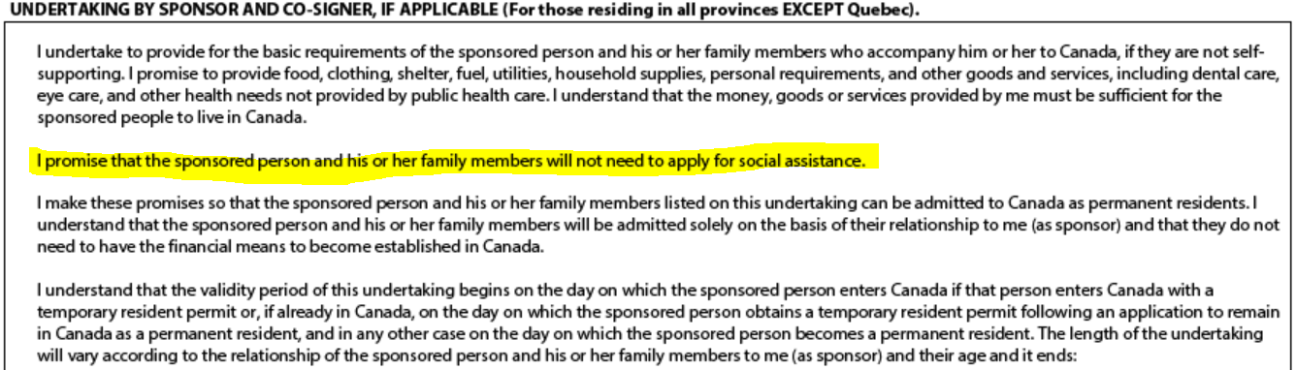
Responsibilities of Sponsors
Excerpt from Sponsorship application form (IMM1344)
Notes:
Excerpts from the IMM1344 — Application to Sponsor, Sponsorship Agreement and Undertaking immigration form — which sets out the details of the undertaking.
When a sponsor files an application to sponsor a family member, they must sign a written agreement called an “undertaking”;
The undertaking is found in the Application to Sponsor immigration form;
We have included an excerpt of the undertaking to highlight the serious language is used;
The undertaking lists the sponsor’s responsibilities;
Sponsors should carefully read and pay attention to this section of the immigration form before signing.
Highlighted portion: I promise that the sponsored person and his or her family members will not need to apply for social assistance.

Slide 62
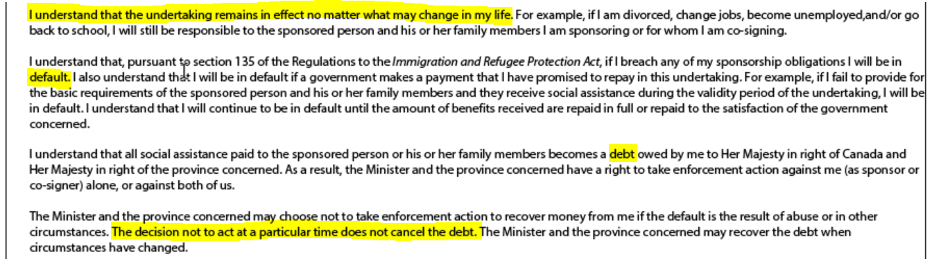
Sponsored Person Receiving SA
Excerpt from Sponsorship application form (IMM1344)
Notes:
Excerpts from the IMM1344 — Application to Sponsor immigration form which sets out the details of the undertaking.
Highlighted portion: I understand that the undertaking remains in effect no matter what may change in my life. For example, if I am divorced, change jobs, become unemployed, and/or go back to school, I will still be responsible to the sponsored person I am sponsoring.
If I breach any of my sponsorship obligations I will be in default.
I understand that all social assistance paid to the sponsored person becomes a debt to the government.
The government and the province may choose not to take enforcement action to recover money if the default is the result of abuse or in other circumstances. The decision not to act at a particular time does not cancel the debt.

Slide 63
Sponsored Person Receiving SA
If a sponsored family member receives social assistance during the undertaking period, the sponsor may be found to be in sponsorship “default”
The sponsor will be asked to repay the government the amount of social assistance their family member received
Notes:
How do sponsors find out the person they sponsored has applied for social assistance?
Sometimes staff at local social assistance offices contacts them on behalf of the Ministry of Community and Social Services, and asks why they aren’t supporting the person.
Sometimes they don’t (in situations where sponsorship has broken down/violence) so they may only find out later (or if they try to sponsor someone else in the future). There are a range of responses. But the main point is there is little flexibility about having to pay for it.

Slide 64
Sponsored Person Receiving SA
Excerpt from Sponsorship application form (IMM1344)
Notes:
Excerpts from the IMM1344 — Application to Sponsor immigration form which sets out the details of the undertaking.
Highlighted portion: I understand that the undertaking remains in effect no matter what may change in my life. For example, if I am divorced, change jobs, become unemployed, and/or go back to school, I will still be responsible to the sponsored person I am sponsoring.
If I breach any of my sponsorship obligations I will be in default.
I understand that all social assistance paid to the sponsored person becomes a debt to the government.
The government and the province may choose not to take enforcement action to recover money if the default is the result of abuse or in other circumstances. The decision not to act at a particular time does not cancel the debt.

Slide 65
Scenario 4: Celina and Isaac
Celina sponsored Isaac who became a permanent resident in 2019.
After coming to Canada, he became aggressive and would often yell at Celina. Celina didn’t feel safe, and her friends offered her help to leave him.
Does Celina have to continue to live with her husband?
Notes:
Read scenario to participants and ask them to put Yes or No in the chat.

Slide 66
Scenario 4: Celina and Isaac
No: Celina doesn’t have to remain in a relationship with her husband.
Isaac has no obligation to remain in the relationship with her either. He will not lose his status if they split up after he becomes a permanent resident.
If, after splitting up, Isaac applies for social assistance tomorrow, will Celina be in default of her undertaking?
Notes:
NO. IRCC acknowledges that they don’t expect people to remain in abusive relationships.
But assuming they separate and Isaac applies for OW, what will happen? Ask participants to answer YES or NO in the chat again.

Slide 67
Scenario 4: Celina and Isaac
YES. Celina will likely be found to be in default.
However, Celina’s safety and well-being is most important.
Government can:
“defer” payment of the debt, or
accept a minimum monthly payment
If Celina gets a letter saying she is in default, she should seek legal advice.
Notes:
The sad answer is likely yes — she will be found in default of the undertaking. Because the government doesn’t want people in Celina’s situation to feel trapped, or in danger, it may agree to “defer” payment of the debt or accept a minimum monthly payment. They can lower the amount, stretch it out over time, but they never “forgive” the debt.
They can also defer payment, say, if the sponsor is now on ODSP, the government won’t collect their ODSP benefits to pay the debt, but it stays with them in case they get off ODSP and start working, then would have to repay.

Slide 68
Immigration Status | Eligible for SA? | Potential consequences to Immigration application?
PR applicant | YES | YES for OW, YES for ODSP
Sponsor | YES | YES for OW, not for ODSP
Sponsored person | YES | YES for OW and YES for ODSP
H & C applicant | YES | YES, unless exemption granted
Refugee claimant | YES | NO
Protected person | YES | NO
TRP Holder | MAYBE | YES, unless exemption granted
Notes:
This chart summarizes some of the discussion on the previous slides. Recall that one possible impact for an H & C application of receiving social assistance (OW or ODSP) is that this fact can harm the applicant’s “establishment” in Canada. But it is possible to get an exemption if there are compelling reasons why the person receives OW/ODSP.
There are two potential consequences of a sponsored person receiving social assistance (both OW and ODSP):
If they are not PRs or citizens, it makes them inadmissible
If they receive social assistance, after they become PR, during the undertaking, the sponsor will accumulate the debt

Slide 69
What can community workers do?
Help clients understand the difference between receiving ODSP and OW for some immigration applications
Help clients apply for SA who need assistance because of a barrier (language, disability)
Warmly refer clients to their local legal clinics, who can assess eligibility and immigration consequences
*If the person has an immigration lawyer, talk to that person first.
Notes:
Community workers can provide support to clients so they understand the importance of sponsorship “undertakings” and the impact of receipt of OW in some situations
Community workers can also help clients know when to seek legal advice
Always remember that legal clinics are available to help, particularly with a request to defer payment of a default of an undertaking, or a request to reconsider a sponsorship, where the person being sponsored received ODSP through their partner and didn’t understand the consequences.

Slide 70
Questions?
Notes:
(This slide will be up on the screen while the Q & A sessions are going on.)
10 minutes

Slide 71
CLEO Resources — Steps to Justice
Social assistance and immigration status:
I don’t have status in Canada. Can I get OW?
What information do I need about my immigration status to qualify for OW?
Sponsoring family members
Income assistance
Notes:
If there is time, walk participants through the Steps to Justice resources on this slide.
If there is Wi-Fi (in an in-person workshop), go to Steps to Justice website *https://stepstojustice.ca/ to highlight the variety of legal questions there, particularly those regarding immigration status and social assistance. Tell them this slide has links embedded, and you will share slides after the presentation.
For online training, share your screen and show participants a few Steps to Justice questions and resources.
CLEO also has COVID-specific legal information on social assistance and immigration status and other legal topics, for example, housing and workers’ rights.
Finally, say that CLEO resources can be ordered online to print and distribute.
*Website URLs and hyperlinks in PowerPoint’s notes are not ‘live’. You will have to cut and paste links into your browser.

Slide 72
Where to get legal help?
Community legal clinics
Speciality legal clinics
Other legal information:
Income Security Advocacy Centre (ISAC) — specialty legal clinic with mission to address systemic issues in respect of income security programs
FCJ Refugee Centre (Toronto) — information sessions/webinars for communities and front-line workers serving vulnerable newcomer, non-status and precarious migrant populations
CBSA website list of Temporary Suspension of Removal (TSR) and Administrative Deferral of Removal (ADR) countries
Notes:
Explain that people can use the search function to find their local legal clinic. There are also many specialty clinics that serve specific populations: Black Legal Action Centre (BLAC), Centre for Spanish-Speaking Peoples (CSSP), South Asian Legal Clinic of Ontario (SALCO), Chinese and Southeast Asian Legal Clinic (CSALC), and HIV & Aids Legal Clinic Ontario (HALCO).
*Website URLs and hyperlinks in PowerPoint’s notes are not ‘live’. You will have to cut and paste links into your browser.

Slide 73
Campaigns and Organizing
Campaigns:
Canada Child Benefit (CCB) advocacy
Colour of Poverty Colour of Change
ISARC Faith Communities in Action Against Poverty
Basic Income Project
Just Recovery Ontario
Health Network for Uninsured Clients | Wellesley Institute
Organizing around Disability issues:
ODSP Action Coalition
Defend Disability
Notes:
The law and policies concerning access to social assistance are being challenged by many organizations throughout Ontario who push for equal access and liveable social assistance amounts.
One example is the Child Tax Benefit Campaign which is pushing for access to Canada Child Benefits for all children living in Canada. This campaign includes a petition participants can sign.
Highlight other organizations relevant to participants and add any other local initiatives here.
*Website URLs and hyperlinks in PowerPoint’s notes are not ‘live’. You will have to cut and paste links into your browser.

Slide 74
Photo credits from Slide 11
Migrant workers: The Western Producer, September 10, 2020
Woman with two children: Canadian Council for Refugees (CCR) website
RCMP officer holding child: CTV Paul Chiason the Canadian press, Feb.17, 2017
Caregiver protesting: NB media, December 17, 2014
Notes:
*Website URLs and hyperlinks in PowerPoint’s notes are not ‘live’. You will have to cut and paste links into your browser.

Slide 75
Thank you!
Include your clinic information and your
contact email
Notes:
Include your clinic’s information and your contact email on this slide.
Add any details about your clinic’s intake process that you wish to share.

Slide 76

We want your feedback!
Notes:
Respond to any outstanding questions
Distribute evaluation form that participants can fill out and email to you after the training or complete on the spot (usually gets a higher response rate)
Ask participants if they want to share any feedback about the training

Slide 77
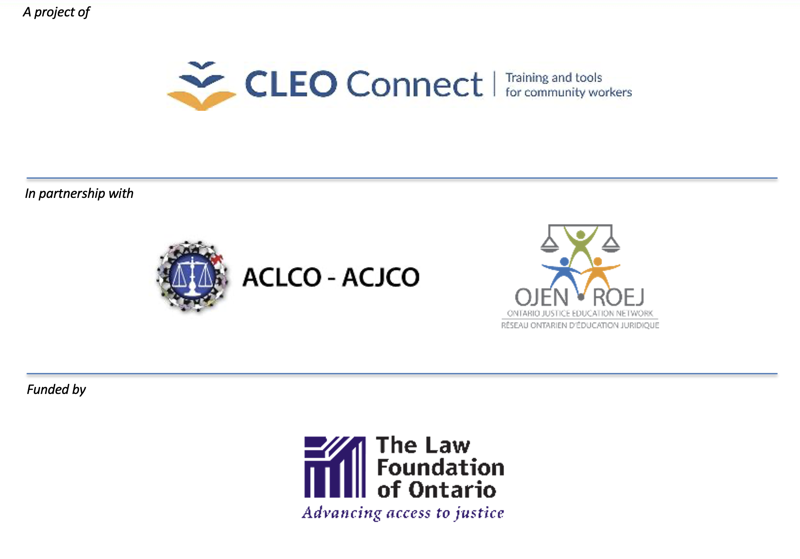
Notes:
Highlight funding from The Law Foundation of Ontario — and that this training is part of a series developed by CLEO in collaboration with the ACLCO (Association of Community Legal Clinics of Ontario) and OJEN (Ontario Justice Education Network) and a clinic advisory group from across the province.
Acknowledge the expertise and invaluable assistance of Community Legal Services of Ottawa (CLSO), Income Security Advocacy Centre (ISAC), and Willowdale Community Legal Services (WCLS) in the creation of this resource.

