Slide 1


Introduction to Human Rights & Disability Law in Ontario
Insert clinic name
Date…
Notes:
You can add your clinic logo here. You can also remove or keep the CLEO Connect logo as you customize your training.
Introduce yourself, your legal clinic and catchment area, and provide any other relevant information.
Depending on the number of participants, have participants introduce themselves.
Invite participants to say or ‘chat’ one thing that they hope to learn from the session.
Depending on your audience, you might also want to say that:
There are 73 legal clinics in Ontario.
60 have geographic catchments throughout Ontario.
13 provide services to specific populations for example: Advocates for Injured Workers Student legal clinic; Advocacy Centre for Tenants (ACTO); Justice for Children and Youth (JFCY); Black Legal Action Centre (BLAC); Aboriginal Legal Services (ALS)

Slide 2






Creating Safer Spaces
Right to Pass
Q and A
Polling and whiteboard
Reminder — mute mic when not sharing
Remember folks on the phone
Chat and private message functions
Notes:
Explain technical details related to the platform and format of the training (for example: muting microphones, polling features, creating virtual background, etc.)
Emphasize the intention is to create an anti-oppressive environment for participants to learn, and share perspectives and experiences among the group. Briefly discuss:
the right to pass (don’t have to answer a question or make contribution if don’t want to);
confidentiality (what is learned, leaves, and what is shared, stays); and
respect for each other.
Explain that you want to encourage thought and discussion, that this content may be NEW to some participants, and that all questions are welcome.

Slide 3
Land Acknowledgment
[Add a meaningful land acknowledgment connected to where you are delivering the workshop]
Notes:
Take time to pause and acknowledge the current occupation of Indigenous land and territory by settlers in Canada and our treaty obligations.
Work with folks in your communities to develop a land acknowledgment that speaks to colonialism and how it connects to your work. You can include examples of active allyship.

Slide 4
Agenda
Welcome and introductory activity
Human Rights laws in Canada and Ontario
Ontario’s Human Rights Code
Duty to Accommodate
Proving the “Discrimination Equation”
BREAK
6. Applying the discrimination equation: two scenarios
Human Rights Tribunal of Ontario
What can community workers do? | Resources
Evaluation and wrap-up
Notes:
Say that you will aim to follow this agenda, and when you are open to questions and discussion as you go through the material. There will be a break.
Discuss the role of community workers in providing information and in referring service users to further help. This includes pointing someone to legal information and helping them understand it. Their role is not to give legal advice, make specific recommendations or predict what will happen.
Let participants know you will be sharing the ‘Resources’ slides later (The slides are at the end of the slide deck.)

Slide 5
Activity 1
Introduction to Human Rights:
Myth Busting
Notes:
ACTIVITY 1
Introduction to Human Rights — Myth Busting
There are 5 statements in this activity.
Pose each statement and get participants to choose TRUE or FALSE.
Discuss misinformation or assumptions that clients or the public may have about human rights, in particular concerning health and disability.
Ask the group if they are surprised by any of the answers. Say that you’ve included another slide with the correct answers.
Use the discussion to ask participants to share any questions that they hope will be addressed in the workshop.
In-person instructions: Use a simple show of hands or have participants share their answers.
Online instructions: Create a TRUE/FALSE poll to pose each statement (one at a time) and ask participants to choose TRUE or FALSE. Or ask them to raise a digital hand or use the chat feature to type their response.

Slide 6

Introduction to Human Rights — Myth Busting 1
To win a human rights case you must prove that someone intended to discriminate against you.
Notes:
[Myth Busting Activity — see instructions in notes at slide 5]
Answer: False
Discrimination does not have to be intentional. A person who has filed a human rights application does not have to prove that the other person or an organization intended to discriminate against the person who filed the application. This is a long-established principle of human rights and anti-discrimination law in Canada.
In 1985, in a case involving the interpretation of Ontario’s Human Rights Code, Mr. Justice McIntyre writing on behalf of a unanimous judgment the Supreme Court of Canada stated: “The proof of intent, a necessary requirement in our approach to criminal and punitive legislation, should not be a governing factor in construing human rights legislation aimed at the elimination of discrimination. It is my view that the courts below were in error in finding an intent to discriminate to be a necessary element of proof.” See, 1985 CanLII 18 (SCC), [1985] 2 SCR 536. Ont. Human Rights Comm. v. Simpsons-Sears.

Slide 7
Introduction to Human Rights — Myth Busting 2
During a job interview an employer can ask me questions about my health and whether I have any disabilities.
Notes:
[Myth Busting Activity — see instructions in notes at slide 5]
Answer: False.
Medical assessments should only take place after a conditional offer of employment is made, and preferably a written offer. Medical assessment must be limited to verifying or determining a person’s ability to perform essential job duties. This allows an applicant with a disability the right to be considered exclusively on her or his merits during the job selection process. For more information and guidance, see the Ontario Human Rights Commission's website at:
http://www.ohrc.on.ca/en/iv-human-rights-issues-all-stages-employment/6-requesting-job-related-sensitive-information
*Website URLs and hyperlinks in PowerPoint’s notes are not ‘live’. You will have to cut and paste links into your browser.

Slide 8
Introduction to Human Rights — Myth Busting 3
My partner and I want $100,000 worth of life insurance to cover our new mortgage. The insurance company can require us to get medical exams first because we are between 46 and 50 years old.
Notes:
[Myth Busting Activity — see instructions in notes at slide 5]
Answer: True.
Ontario’s Human Rights Code allows insurance companies to make distinctions in individual insurance policies and (non-employment) group insurance policies based on age, sex, marital status, family status or disability. This is an exception to the general rule of non-discrimination in the Code. Any distinctions must be made on reasonable and bona fide grounds.

Slide 9
Introduction to Human Rights — Myth Busting 4
A restaurant can ask a person to stop breastfeeding, cover themselves or to go to the washroom if they want to breastfeed.
Notes:
[Myth Busting Activity — see instructions in notes at slide 5]
Answer: False.
Ontario’s Human Rights Code prohibits discrimination against women who are pregnant and breast-feeding in services, goods and facilities. This includes public places like malls and parks. Women who are pregnant, or who bring their babies to a restaurant or theatre, can’t be denied service or access unless there is a legitimate reason for doing so.
You can share this link with participants in the chat:
http://www.ohrc.on.ca/en/policy-preventing-discrimination-because-pregnancy-and-breastfeeding
This is an example of the helpful resources about the Ontario Human Rights Code that are listed at the end of the slides.
*Website URLs and hyperlinks in PowerPoint’s notes are not ‘live’. You will have to cut and paste links into your browser.

Slide 10
Introduction to Human Rights — Myth Busting 5
A doctor with religious beliefs about the “sanctity of human life” can refuse to discuss medical assistance in dying (MAiD) with a patient.
Notes:
[Myth Busting Activity — see instructions in notes at slide 5]
Answer: True, but the doctor would have a legal duty to provide the patient with an "effective referral", meaning a "referral made in good faith to a non-objecting, available, and accessible physician, other health-care professional, or agency.” This effective referral principle was upheld recently in an appeal.

Slide 11
Myth Busting Answers
Intention to discriminate is needed to prove discrimination. FALSE
Potential employer can ask about health and disabilities during interview process. FALSE
Code allows insurance companies to make genuine distinctions in individual insurance policies. TRUE
Can deny access or service to pregnant and breastfeeding women. FALSE
A doctor can refuse service based on religious belief, but must offer “effective referral”. TRUE
Notes:
ANSWERS — MYTH BUSTING ACTIVITY
Remind participants that they will get a copy of the slides.

Slide 12
Learning Goals
Learn about human rights legal protections under Ontario law
Understand the “Discrimination Equation”
Learn about legal information, self-help resources, and referrals for clients
Notes:
Explain that the goals of today’s training are to:
provide participants with an introduction to human rights protections under Ontario law;
increase participants understanding of human rights protections under Ontario law with a focus on disability;
familiarize participants with helpful resources they can share with service users; but
tell participants that you will explain the “Discrimination Equation” to help them understand what constitutes illegal discrimination, NOT to make them experts in human rights law or to provide legal advice to service users.
Ask if they have any questions — remind them that there will be many opportunities to ask questions and discuss this topic. Acknowledge that it can be a difficult topic to talk about.

Slide 13
Human rights, anti-discrimination & equality law in Canada and Ontario

Slide 14
Charter and Human Rights Laws
Section 15 of the Canadian Charter of Rights and Freedoms (the “Charter”) sets out equality guarantees
Provincial, territorial and federal human rights laws outlaw discrimination
Notes:
Explain to participants that today, the two principal sources of human right protections against discrimination, and the legal guarantee of equality, in Canada are:
Section 15 of the Canadian Charter of Rights and Freedoms—a federal law; and
Federal, provincial and territorial human rights laws, such as Ontario’s Human Rights Code and the Canadian Human Rights Act

Slide 15
Charter Equality Guarantee
Canadian Charter of Rights and Freedoms
Part of Canada’s constitution
Charter Section 15—equality rights
Federal law, applies throughout Canada
Applies to laws, governments & government actions
Federal, provincial, territorial, municipal and other “government” actors
Notes:
The Charter has constitutional status. It is the supreme law of Canada—all other laws must conform to the rights, guarantees and protections set out in the Charter. It is part of the fundamental law that organizes Canadian society, and it can’t be changed by the federal government without the agreement of the provinces.
Paraphrase the Charter section 15 (equality guarantee)
Every individual is equal before and under the law and has the right to the equal protection and equal benefit of the law without discrimination (s 15(1))
Section 15(2) affirmative action programs not discriminatory
The Charter only guarantees rights and protections in relation to the state or government (federal, provincial, territorial and municipal) and government actors. The Charter does not apply to private relationships among people, corporations, or organizations.

Slide 16
Human Rights (anti-discrimination) Laws
Federal, provincial and territorial laws
Ontario’s Human Rights Code
Canadian Human Rights Act
Federally regulated works, undertakings, federal government, and persons covered under the Indian Act
Banks, airlines, railways
Other federal and provincial laws include anti-discrimination protections
Notes:
For example, the Occupational Health and Safety Act (Ontario) includes anti-discrimination.
Explain that over time different words were used in describing the original inhabitants of this land. The Indian Act uses the words Indians to mean First Nations and Bands to describe their system of government. In the Charter of Rights and Freedoms, “Aboriginal Peoples” is used and includes “Indian, Inuit and Metis peoples of Canada”. Today we use Indigenous, which includes First Nations, Métis and Inuk. Sometimes we use very specific words identifying the nation like Haudenosaunee Confederacy (now known as one of the Six Nations) or Anishinabek Nation. Other times the more general terms may be used.
Share this link in the chat: https://www.canada.ca/en/services/jobs/workplace/federally-regulated-industries.html
It is a list that covers who is a federally regulated employee.
*Website URLs and hyperlinks in PowerPoint’s notes are not ‘live’. You will have to cut and paste links into your browser.

Slide 17



Ontario Human Rights Code
Notes:
The Human Rights Code sets out legal protections from discrimination and defences to allegations of discrimination.
The Code is the statutory authority for the Ontario Human Rights Commission, the Human Rights Tribunal of Ontario and the Human Rights Legal Support Centre (HRLSC).
The HRLSC provides legal information, advice and sometimes representation to those who have experienced discrimination. Links to these bodies are included in the ’Resources’ section of these slides.

Slide 18
Protection from discrimination under Ontario’s Human Rights Code

Slide 19
What is discrimination?
Plain meaning of the word
Legal definition
Is there a difference?
Notes:
Ask participants to explain what they think the word discrimination means in everyday language. Ask what they think the legal definition is? Say you have a few examples to try to highlight what it means. Participants can answer in the chat, answer in a poll or use a show of hands for in-person training.
Which of the following situations is potentially discrimination under Ontario’s Human Rights Code:
A neighbour puts up a fence so they don’t have to see a guy kiss his husband. NO. The Code does not apply to purely interpersonal (e.g., neighbour) relationships.
A homeowner rents out rooms to students, but only to students who do not have Canadian citizenship. Everyone in the house shares a kitchen and dining area. NO. This is an exception to the law against discrimination in housing. Where the landlord and the tenants share a kitchen, the Code does not apply. This is covered in section 21(1) of the Code.
Insurance company charges higher car insurance premium to young men than young women. MAYBE. The insurance company would have to show that the distinction between males and females is based on reasonable and good faith grounds—in other words, evidence of risk of accidents based on actuarial data.
Purolator Courier refuses to deliver package because of “ethnic” cooking smells in building. YES. It is illegal for a business to discriminate based on a person’s race, ancestry, place of origin, colour, ethnic origin. This is covered in section 1 of the Code.

Slide 20
Human Rights Code & Discrimination
Establishes protections from discrimination in certain areas of social life, based on protected grounds
Permits special programs to advance groups
Establishes limited defences
Takes away right to sue in civil court for discrimination alone
Notes:
Explain that the Code sets out certain protected grounds — for example: race, ancestry, ethnic origin, creed, sexual orientation, gender identity.
The last point means that someone can’t sue in civil court for an allegation of discrimination on its own, but they can add a “discrimination” claim to lawsuit that includes other legal issues, like wrongful dismissal in employment.

Slide 21
The “Discrimination Equation”
Social area + protected Code ground + negative outcome – defence = illegal discrimination
Notes:
Explain that we can use the equation to help us “spot” potential discrimination.
In other words, use it to understand, analyze and identify real life situations of injustice in legal terms.

Slide 22
Social areas
Services, goods, facilities
Accommodation (ie: housing)
Contracts
Employment
Vocational association and trade-unions
Code applies to Ontario government, broader public sector and private sector in Ontario
Code does not apply to purely private interpersonal relations
Notes:
Explain that the Human Rights Code sets out FIVE social areas.
The Code doesn’t apply to interpersonal disputes between private individuals (e.g., friends, neighbours, family, acquaintances).

Slide 23
+ protected Code ground
Code section 5 (employment) includes protection from discrimination on the following protected “grounds”:
race, ancestry, place of origin, colour, ethnic origin, citizenship, creed, sexual orientation, gender identity, gender expression, age, record of offences, marital status, family status or disability
Notes:
The Code protects what is fundamental to someone’s personhood — their sense of self and identity
Grounds are listed for each social area, with slight variation among social areas, so for example, regarding employment, the Code sets out the following grounds listed here.

Slide 24






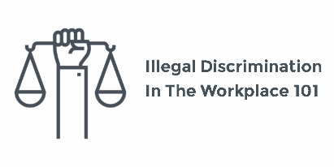
The “Discrimination Equation”
______________________________________________________
=
Notes:
Tell participants that it takes a little practice to remember each part of the “Discrimination Equation”.
Social area + protected Code ground + negative outcome – defence = illegal discrimination

Slide 25
+ negative outcome
Non-economic losses
Loss of right to be free from discrimination
Injury to “dignity, feelings and self-respect”
Economic losses
Loss of job, salary or promotion
Unable to continue with school program, tuition lost
Cost of installing mobility ramp
Other out-of-pocket expenses
Notes:
Explain that the legal analysis of discrimination focuses on effects or outcomes. The Code’s goal is to create a climate of understanding and mutual respect, for the dignity and worth of each person to feel part of the community and to be in a position to contribute to the well-being of the community.
Non-economic losses usually include harm a person’s feelings, dignity, self-respect, and their emotional well-being. Although we usually don’t think about these in terms of dollars and cents, when it comes to compensating a person for the discrimination they have experienced, the Human Rights Code asks people, lawyers, and decision-makers to assign monetary value. The value of a non-economic loss is assessed based on the circumstances of the case compared with cases previously decided by the Human Rights Tribunal of Ontario.
Economic loss includes inability to continue with a school program, lost tuition, the cost of installing a mobility ramp, out of pocket expenses.
Remind participants that discrimination doesn’t have to be intentional (from Myth Busting activity). It can be unintentional.

Slide 26
Many Forms of Discrimination
Direct (including harassment, sexual harassment, sexual solicitation)
Constructive (also known as “adverse effect”)
By association, or perceived
Toxic environment
Systemic, institutional
Reprisal for claiming rights under Code
Notes:
Explain that the Code makes illegal different forms of discrimination as a recognition that many circumstances can amount to illegal discrimination.
This could be a place to include some interactivity — if there is time, ask participants what they think each type means.
Examples of direct discrimination — racist, sexist, homophobic, transphobic, anti-immigrant, anti-Muslim etc.…remarks, slurs, behaviours:
“people on welfare need not apply”
“single employed professionals preferred”
“Canadian citizens only”
Constructive discrimination (aka “adverse effect”) describes situation where:
Rule, policy or practice
Neutral on its face
Applied the same (equally) to everyone
But has negative effect on or outcome for a person or group based on Code ground(s)

Slide 27
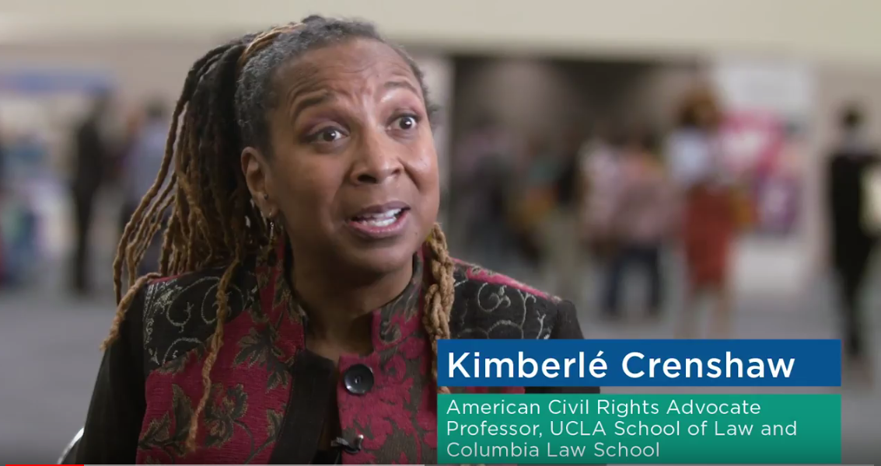
Intersectionality
Notes:
Discrimination can also be based on the “intersection” between two or more protected grounds.
American lawyer, academic and activist Kimberlé Crenshaw developed the concept of ‘intersectionality’ in late 90s to explain how race intersects with gender to produce barriers for Black women. The concept of “intersectional discrimination” has been adopted by the Tribunal and courts in Canada. Feel free to paraphrase or share with participants the following paragraph from the Supreme Court of Canada:
… substantive equality concerns itself with historical or current conditions of disadvantage, products of the persistent systemic discrimination that continues to oppress groups. Substantive equality demands an approach “that looks at the full context, including the situation of the claimant group and . . . the impact of the impugned law” on the claimant and the groups to which they belong, recognizing that intersecting group membership tends to amplify discriminatory effects or can create unique discriminatory effects not visited upon any group viewed in isolation. It must remain closely connected to “real people’s real experiences”: it must not be applied “with one’s eyes shut”. Ontario (Attorney General) v. G, 2020 SCC 38 (CanLII), <https://canlii.ca/t/jbpb4> at paragraph 47 [citations omitted].
Violence against Indigenous women and girls is an example of the need for an intersectional approach to reduce risk and build equity and safety. Statistics show that other groups of women also face disproportionately higher risks of gender-based violence. Women with disabilities and those who are institutionalized, single women, young women, and women who are unemployed or have low incomes are at heightened risk of sexual assault.
Department of Justice statistics on sexual assault — https://www.justice.gc.ca/eng/rp-pr/csj-sjc/ccs-ajc/rr06_vic2/p3_4.html
*Website URLs and hyperlinks in PowerPoint’s notes are not ‘live’. You will have to cut and paste links into your browser.

Slide 28
– defence
Code allows a defence to a claim of discrimination
Two basic types of defences:
Specific defences
Good faith and undue hardship defences (general)
a requirement, qualification or factor is reasonable and made in good faith and
person’s needs can’t be accommodated without undue hardship
Notes:
Explain to participants that the Code allows for a defence, in some situations. Under a Code defence, a distinction based on an enumerated Code ground, in a social area covered by the Code, that has a negative outcome is NOT illegal discrimination—because the Code says so, according to the law passed by the Ontario legislature.
There are two basic types of defences under the Code:
Highlight some examples of specific defences for participants:
Section 14 (special programs) not discriminatory: a special program designed to relieve hardship or economic disadvantage or to assist disadvantaged persons or groups to achieve or attempt to achieve equal opportunity or that is likely to contribute to the elimination of the infringement of rights under Part I.
Section 15 (age 65 or over): not discriminatory where an age of sixty-five years or over is a requirement, qualification or consideration for preferential treatment
Section 16(1) (Canadian citizenship): not discriminatory where Canadian citizenship is a requirement, qualification or consideration imposed or authorized by law.
Section 20(1) (facilities restricted by sex): not discriminatory where the use of the services or facilities is restricted to persons of the same sex on the ground of public decency
Section 20(4) (ban on selling cigarettes to kids): provisions of the Smoke-Free Ontario Act, 2017 and the regulations under it relating to selling or supplying anything to which that Act applies to persons who are, or who appear to be, under the age of 19 years or 25 years, as the case may be are not discriminatory.
Good Faith and Undue Hardship Defences
Section 11(2) and 17(2): Not discriminatory where person’s needs related to a Code ground cannot be accommodated without undue hardship
This is explained in the following section.

Slide 29
Duty to Accommodate … to point of undue hardship
Notes:
You may want to ask participants if they think treating everyone equally is the ideal. If not, why not?

Slide 30
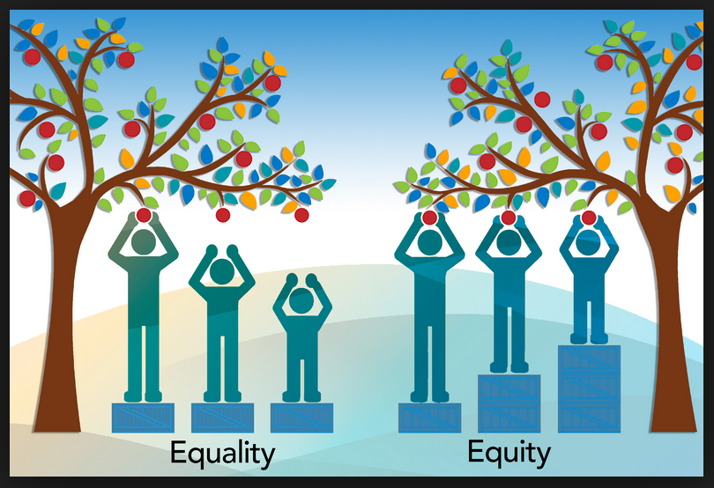
Duty to Accommodate
Notes:
Ask participants what they think this image is trying to convey.
Treating everyone equally does not mean treating everyone the same
Goal is substantive rather than formal equality
Takes into account individual capacity and needs
Levelling playing field in relation to the essentials
For people with disabilities, the Duty to Accommodate is an essential part of promoting social inclusion. The duty is placed on goods — and service-providers and other businesses, employers, and housing providers to takes steps to level the playing field. The Duty to Accommodate helps achieve substantive, rather than formal, equality — in other words, equity.

Slide 31
Accommodation: A Duty and a Defence
Defence to a claim of discrimination where person’s disability-related needs can’t be accommodated without undue hardship
Duty to Accommodate
If person still can’t fulfill essential requirements after appropriate accommodation, undue hardship defence established
Notes:
The Code sets out a Duty to Accommodate disability-related needs where there is discrimination (i.e., social area + protected ground + negative outcome).
The Duty to Accommodate is not absolute or unlimited. “Undue hardship” is the limit, which represents the legal defence to a claim of disability discrimination. When assessing whether an accommodation would cause the respondent “undue hardship”, only three things can be considered: cost, outside sources of funding, and health and safety requirements.
Can the person can fulfil the essential requirements of a role after their disability-related needs have been accommodated, short of causing undue hardship? If not, then there is no illegal discrimination.

Slide 32



Undue hardship factors
Notes:
If the person or organization with the duty to accommodate can prove that providing the accommodation would cause “undue hardship,” it is not illegal discrimination.
It is considered undue hardship if the cost would bankrupt the business or person. Undue hardship also includes where there is a health or safety risk posed to the person or other people.

Slide 33
Accommodation: Housing Examples
Helping someone complete a written or online application for a co-op
Making structural changes to a unit or building to make it accessible
Extending deadline for tenant to submit documents for their annual rent review
Allowing transfer to new unit where “the rules” wouldn’t otherwise permit it
Notes:
These are a few concrete examples of some accommodations that have been used in housing law.

Slide 34
Proving the “Discrimination Equation”

Slide 35
= illegal discrimination
Person claiming discrimination must prove …
Social area + protected Code ground + negative outcome
Must prove on a balance of probabilities (50%+1; more likely than not)
Prove based on evidence
Documents, emails, testimony, witnesses, reports from experts
Notes:
We are getting to the final part of the “Discrimination Equation”. Are these first parts met? Is there evidence to support them? Explain the ‘balance of probabilities’ standard.
Then you go on to consider whether or not it will be considered illegal discrimination.

Slide 36
= illegal discrimination
Person/organization accused of discrimination has the opportunity to establish a …
– defence
On a balance of probabilities, based on evidence
If unable to establish a defence, then
= illegal discrimination
Notes:
Recall from Slide 28:
There are two basic types of defences:
Specific defences written into Code
Good faith defences:
a requirement, qualification or factor is reasonable and made in good faith; and
the person’s needs can’t be accommodated without undue hardship

Slide 37

Time for a break
Notes:
Consider a 10-minute break at this point. Tell participants exactly what time they should return or come back online.

Slide 38
Activity 2
Applying the “Discrimination Equation”: two scenarios

Slide 39
Does it add up to illegal discrimination?
social area: __________________
+ protected Code ground: ________________
+ negative outcome: __________________
– defence: _________________
= illegal discrimination ?
Notes:
Tell participants that they will get a chance to apply the “Discrimination Equation” to fact scenarios to see whether they think each scenario is an example of illegal discrimination.
This is an exercise to make them familiar with the various “parts” of the equation, not to get to one right answer. It isn’t intended to equip workers to provide legal advice or opinions about client circumstances, but to see that the law can be very exacting and that one has to consider and complete each part of the equation.

Slide 40
Scenario 1: Dental discrimination?
AB is living with HIV, is in great health, takes meds, and HIV is at “undetectable levels”. Books a dental check-up with new dentist, has no dental problems.
AB completes the “New Patient Info” form, doesn’t disclose HIV.
In the chair, AB tells dentist about HIV, meds, and “undetectable levels”.
Dentist says can’t do check-up or cleaning, AB has to book a special hour-long appointment.
Dentist explains that they need to take special precautions because of risk to staff, other patients.
Notes:
“Discrimination Equation” — ask participants to think about each of the parts of the equation and apply them to this scenario. What is the social area here? etc.
You can discuss the scenario as a group, or you can divide participants into smaller groups to discuss and report back to the entire group.

Slide 41
Scenario 1: Answer
Social area: services or contract
Enumerated ground: disability (HIV status recognized as a disability under Code)
Negative outcome: Injury to dignity, self-respect; loss of right to be free from discrimination accessing dental services; denial/delay
Defence: None. No health and safety risk to AB or dental staff associated with routine dental check-up and cleaning. Dental staff should be trained in, and dental offices should have equipment needed to carry out, universal precautions for infection control and prevention of blood-borne pathogens.
Illegal Discrimination: Yes
Notes:
“Discrimination Equation” Answer
Social area: services or contract
Enumerated ground: disability (HIV-positive status recognized as a disability under the Code)
Negative outcome: Injury to dignity, feelings and self-respect; loss of right to be free from discrimination in accessing dental services; denial/delay in dental check-up and cleaning
Defence: None. No health and safety risk associated with routine dental check-up and cleaning. Dental offices should be trained in and have equipment to carry out universal precautions for infection control in relation to blood-borne pathogens.
Illegal Discrimination: Yes
Worth mentioning: A dentist may not be able to provide you with the best possible care if they do not know about your HIV status. If you don’t disclose and something goes wrong with your care, and you suffer damage related to not disclosing, by not disclosing your HIV status you might have reduced or eliminated the chance to recover money in a lawsuit for malpractice.

Slide 42
Scenario 2: Workplace discrimination?
ZZ works on the line at a factory. Shifts are based on union seniority. ZZ has worked the midnight to 8 a.m. shift for one year.
ZZ has a degenerative eye disease that might eventually cause blindness. ZZ can enrol in a clinical drug trial, but must go to a clinic at 6 a.m., 3 times a week, for 2 months.
Employer refuses to allow ZZ to change shifts. ZZ does the drug trial using sick days, but eventually runs out of sick days and is fired for missing work.
Union refuses to grieve termination because “seniority is a fundamental right for our union members”.
Notes:
“Discrimination Equation” — ask participants to think about each of the parts of the equation and apply them to this scenario: What is the social area here? etc.
You can discuss the scenario as a group, or you can divide participants into smaller groups to discuss and report back to the entire group.

Slide 43
Scenario 2: Answer
Social area: Employment and vocational association
Enumerated ground: disability (degenerative eye disease)
Negative outcome: Loss of employment; injury to dignity, feelings and self-respect; loss of right to be free from discrimination in employment
Defence: None. Employer and union have duty to accommodate disability, which could have been fulfilled by allowing ZZ to change shifts for two months, allowing ZZ to exceed maximum number of sick days allowable.
Illegal Discrimination: Yes
Notes:
“Discrimination Equation” — Answer
Social area: Employment and vocational association (Union)
Enumerated ground: disability (degenerative eye disease)
Negative outcome: Loss of employment; injury to dignity, feelings and self-respect; loss of right to be free from discrimination in employment
Defence: None. Employer and union have duty to accommodate disability, which could have been fulfilled by allowing ZZ to change shifts for two months, or allowing ZZ to exceed maximum number of sick days allowable.
Illegal Discrimination: Yes.
Worth mentioning: ZZ could file an Application with the Human Rights Tribunal of Ontario naming the employer and the union as respondents.

Slide 44
Human Rights Tribunal of Ontario (HRTO)
Notes:
If there is time, ask participants who they think can represent a person in an Application to the Human Rights Tribunal:
Lawyer
Paralegal
Law student at a legal clinic
A trade union volunteer
An immigration consultant

Slide 45
Human Rights Tribunal of Ontario
Free, no cost process
You can represent yourself, or be represented by a lawyer, paralegal or an “exempt person”
You can have a support person

Slide 46
Direct Access to HRTO
Anyone can make a complaint to the
Human Rights Tribunal of Ontario (HRTO)
within one year of incident (or the last in a series of incidents)
Notes:
Tell participants that a complaint is called an ‘application’ that starts the HRTO process. The incident that leads to the complaint must have taken place in Ontario. It is important to emphasize the one-year limitation period and the fact that the HRTO takes a very hard line on this. It is difficult to bring a complaint after one year has passed.

Slide 47
Timelines at HRTO
Filing Application to Mediation
1 year to 18 months
Mediation to Hearing
Another 9 months to 1 year
Hearing to Written decision
???
Interim Motions can slow down process
Notes:
Explain that the human rights process can be quite drawn out, and slow. This can take quite an emotional and psychological toll on clients. It can take up to 6 months to get a decision after the hearing.
It is important that people considering making an application know that the process is public. This is intended to make sure that discriminatory behaviour is brought to light and corrected. In some circumstances, it is possible to apply just using a person’s initials, but they should seek legal advice about doing this. If there is time, ask participants how they think they can support someone who has come to them alleging they have been discriminated against?

Slide 48
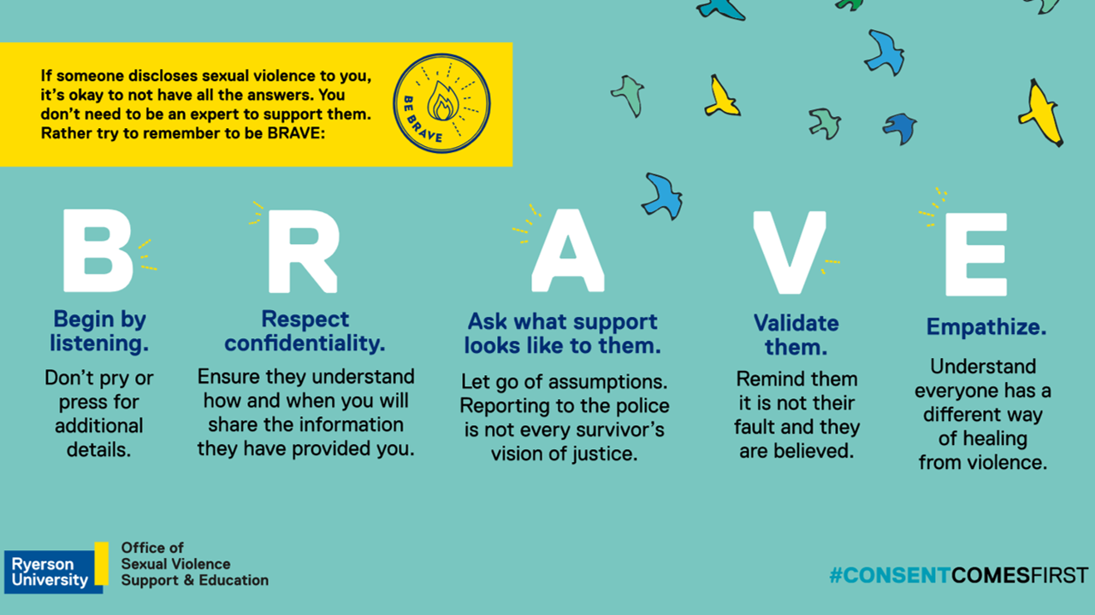
Supporting a client’s disclosure
Notes:
This is an infographic created by Ryerson University, Office of the Sexual Violence Support and Education. The “BRAVE” way of supporting clients might also be useful where clients disclose violations of their legal rights and experiences of harassment and discrimination.
Briefly walk through each letter on the slide and ask participants if they have any comments or reaction to the BRAVE message that they would like to share.
B — Sometimes people just want someone else to listen. Now is not the time to rush to offer them advice or suggestions on what they can do. Suggest, if they are up to it, that you can provide referrals.
R — Explain your obligations in reporting, whether as set out by your employer or professional organization (usually when criminal in nature or imminent harm). Make sure you know your internal processes.
A — Ask what they are hoping to do and how you can support them with that.
V — By validating them, you are not admitting they are right and the other party is wrong/guilty; you are validating how they feel and felt in the moment. You are acknowledging that they believe something happened.
E — They may never raise the issue with you again, they may never report it beyond you. That is okay. Whatever they chose to do is up to them.

Slide 49
What can community workers do?
Active listening
Recommend good record keeping
Keep “Discrimination Equation” in mind
Referral to psycho-social supports
Legal information and referrals, provided early, don’t wait for negative outcome(s)
Support client to access legal advice
Notes:
Tell participants that they can keep the “Discrimination Equation” in mind to enhance their capacity to make appropriate referrals for legal advice about discrimination. A warm referral is best.
It is also important to provide good and timely legal info and referral information as well as emotional supports for clients experiencing discrimination/harassment.
Legal advice can be preventative and help people avoid worst-case outcomes like losing a job or housing, or suffering ongoing harassment. Legal advice can empower people to navigate difficult situations, document what's happening to them, and assert their rights and advocate for decent outcomes before they suffer (more) harm or loss. Getting legal advice is also the first step to getting legal representation.

Slide 50

Questions?
Notes:
Ask participants if they have any final questions before you discuss the resources, which begin on the next slide.

Slide 51
CLEO Resources – Steps to Justice
I was discriminated against. What are my options?
What can I do if I'm being harassed at work?
I'm transgender or non-binary. What are my rights at work?
How do I make a claim to the Human Rights Tribunal of Ontario?
Notes:
Walk participants through the Steps to Justice resources on this slide.
If there is Wi-Fi (in an in-person workshop), go to Steps to Justice website https://stepstojustice.ca/ to highlight the variety of legal questions there, particularly those regarding human rights and disability. Tell them this slide has links embedded, and you will share slides after the presentation.
Explain that Steps to Justice includes clear legal information on common questions people have about discrimination (and other legal topics as well)
For online training, share your screen and show them a few Steps to Justice questions and resources. This page highlights sample Steps questions about human rights, harassment, and discrimination.
Finally, say that CLEO resources can be ordered online to print and distribute to clients in the community.
*Website URLs and hyperlinks in PowerPoint’s notes are not ‘live’. You will have to cut and paste links into your browser.

Slide 52
Where to get legal help?
Local Community Legal Clinic
Speciality legal clinics
Human Rights Legal Support Centre – Free information, advice, and representation
Tel: (416) 597-4900 / Toll Free: 1-866-625-5179
Frequently Asked Questions
How-to Guides
Notes:
If your clinic practice includes human rights, insert clinic info and how to access intake. Tell participants they can use the link in this slide to access their local clinic by inserting their postal code.
This slide also includes a link to the many specialty clinics that serve specific populations and may practice in human rights law: Black Legal Action Centre (BLAC), Centre for Spanish-Speaking Peoples (CSSP), South Asian Legal Clinic of Ontario (SALCO), Chinese and Southeast Asian Legal Clinic (CSALC), and HIV & Aids Legal Clinic Ontario (HALCO).
Explain that the Human Rights Legal Support Centre was established by law, under Ontario’s Human Rights Code. It provides a staged approach to services, does an assessment of the strength of the complaint and the person’s ability to represent themselves.
Remind participants that you will share these slides after the presentation and that the resources are hyperlinked in the slides.

Slide 53
Human Rights Tribunal of Ontario
Application and Hearing Process
FAQs, Videos, Guides
Forms & Filing
Rules & Practice Directions
Notes:
The Human Rights Tribunal of Ontario was also established by law under Ontario’s Human Rights Code. Their website has many helpful resources about the process, videos and guides that discuss human rights and discrimination, and self-help guides.

Slide 54
Human Rights Commissions
Ontario Human Rights Commission
Brochures, Factsheets & Guides
Policies & Guidelines
Canadian Human Rights Commission
How to file
Complaint FAQs
List of federally regulated industries
Notes:
The Ontario Human Rights Commission was also established under Ontario’s Human Rights Code. Their website includes legal information, resources and policy statements.
The Canadian Human Rights Commission is for federally regulated industries — see the list included. The site includes similar resources and legal information relevant to the Canadian Human Rights Act and areas of federal jurisdiction

Slide 55
Thank you!
Include your clinic information and your
contact email
Notes:
Include your clinic’s information and your contact email on this slide. Add any details about your clinic’s intake process that you wish to share.
Acknowledge the expertise and invaluable assistance of the HIV & AIDS Legal Clinic Ontario (HALCO) in the creation of this resource.

Slide 56

We want your feedback!
Notes:
Distribute evaluation form that participants can fill out and email to you after the training or complete on the spot (this usually gets a higher response rate)
Ask participants if they want to share any feedback about the training

Slide 57
Notes:
Highlight funding from Law Foundation of Ontario — and that this training is part of a series developed by CLEO in collaboration with ACLCO and OJEN as part of a clinic advisory group from across the province

