Slide 1
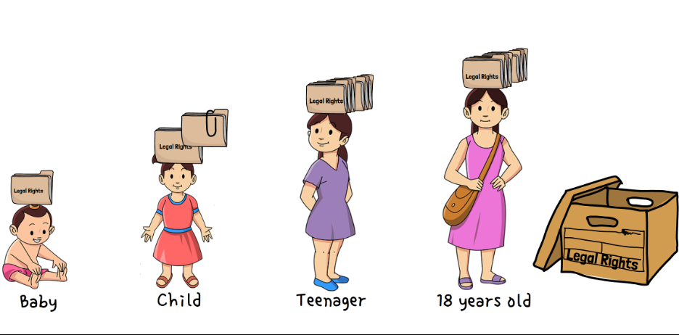

Understanding Youth Rights
Your clinic’s NAME goes here
DATE
Legal information for community workers
Notes:
You can add your clinic logo here. You can also remove or keep the CLEO Connect logo as you customize your training.
Introduce yourself, your legal clinic and catchment area. Explain what your legal clinic does and your role at the clinic.
Depending on the number of participants, have participants introduce themselves.
Invite participants to say or ‘chat’ one thing that they hope to learn from the session.
Depending on your audience, you might also want to say that:
There are 73 legal clinics in Ontario.
60 have geographic catchments throughout Ontario
13 provide services to specific populations — for example: Justice for Children and Youth (JFCY); Black Legal Action Centre (BLAC); Aboriginal Legal Services (ALS) Advocates for Injured Workers Student Legal Clinic

Slide 2
Agenda
1. Welcome
2. Introduction to Youth Rights – Myth Busting
3. Youth Rights video and discussion
4. A Youth Rights Framework for Community Workers
BREAK
5. Scenarios and discussion
6. Self-reflection and discussion
7. What can community workers do? | Resources
8. Wrap-up and feedback
Notes:
Say that you will aim to follow this agenda, and that you are open to questions and some discussion as you go through the material. Let participants know there will be a break.
Discuss the role of community workers in providing helpful information and in steering someone to further help.
Inform participants that the aim of the training is NOT for them to become experts in youth rights, but rather to increase their understanding, and to become familiar with helpful resources they can share.
Tell participants that you will be sharing the slides with them after the presentation.

Slide 3






Creating Safer Spaces
Right to Pass
Q and A
Polling and whiteboard
Reminder — mute mic when not sharing
Remember folks on the phone
Chat and private message functions
Notes:
Explain technical details related to the format of the training (for example: muting microphones, polling features, creating a virtual background, etc.)
Emphasize the goal to create an anti-oppressive environment. Briefly discuss: the right to pass (participants don’t have to answer a question or make a contribution if they don’t want to); confidentiality (what is learned, leaves, and what is shared, stays); and respect for each other.
Explain whether you like to have questions raised as you go along or at specific times, and when the break will be.
Explain that you want to encourage thought and discussion, that this content may be NEW to some participants, and that all questions are welcome.

Slide 4
Land Acknowledgment
[Add a meaningful land acknowledgment connected to where you are delivering the workshop]
Notes:
Take a moment to pause and invite participants to acknowledge the current occupation of Indigenous land and territory by settlers in Canada.
Work with folks in your community to develop a land acknowledgment that speaks to colonialism and how it connects to your work. Consult Indigenous partners in your region. You may wish to include examples of active allyship.

Slide 5

Introduction to Youth Rights — Myth Busting
A 16-year-old can get married with their parent’s permission.
Notes:
Introduction to Youth Rights — Myth Busting Activity
There are 5 statements in this activity.
Pose each statement and get participants to choose TRUE or FALSE.
Discuss misinformation or assumptions that clients or the public may have about youth rights.
Ask the group if they are surprised by any of the answers. Say that you’ve included another slide with the correct answers.
Use the discussion to ask participants to share any questions that they hope will be addressed in the workshop.
In-person instructions: Use a simple show of hands or have participants share their answers.
Online instructions: Create a TRUE/FALSE poll to pose each statement (one at a time) and ask participants to choose TRUE or FALSE. Or ask them to raise a digital hand or use the chat feature to type their response.
Answer: TRUE. First, you can inform participants that a 16-year-old in Canada is legally able to consent to sexual activity with an adult of any age.
Many cultural groups in Canada believe that having a baby out of wedlock is wrong; 16-year-olds in those cultural groups who do have a baby out of wedlock may be shunned or mistreated, which is not good for the baby or the young person. Allowing a 16-year-old youth the right to marry with parental consent recognizes the relative maturity of a 16-year-old to make their own decisions about intimate relationships, and it also acts as a buffer against the cultural norms of having a baby out of wedlock.
If a parent withholds consent, the 16-year-old cannot get married as the law stands right now.

Slide 6
Introduction to Youth Rights — Myth Busting
A child under age 12 can only get medical treatment if the parent approves.
Notes:
[Myth Busting Activity — see instructions in notes at slide 5]
Answer: FALSE. Ask participants why they think this might be false.
Inform participants that the parent’s consent is not needed. The child’s ability to refuse depends on their capacity (discussed below).
The law recognizes that no one’s bodily integrity should be interfered with unless the person gives consent.
Using a specific age as the age of consent for medical purposes (for example, age 12) would be arbitrary. There are some issues that 12-year-olds can understand and decide on their own, and there are some 12-year-olds who are more mature than others. There will also be some issues that a 6- or 7-year-old child can understand and decide on their own, and some 6- or 7-year-old children who are more mature than others. In some situations, the law uses arbitrary ages (e.g.,16-years-old for getting a driver’s licence). But for bodily integrity or medical consent, setting an arbitrary age is unfair and potentially dangerous.
Instead, the law uses the idea of “mental capacity”. There are two factors in determining mental capacity. A person of any age can consent or refuse to consent if they understand:
1. the medical treatment involved
2. the consequences of getting the treatment or refusing the treatment
A person’s mental capacity is different in different situations and at different stages of development. For example, a 5-year-old has the right to choose between strawberry- or blueberry-flavoured medicine. The child has the mental capacity to fully understand that decision. But they don’t have the mental capacity to understand what the medicine does, or whether taking it is a good idea. So even though the child gets to pick the flavour because they understand that part of the decision, the parent gets to decide whether or not the child takes the medicine because the child doesn’t understand that part of the decision.
You can also discuss the recent situation of the availability of COVID vaccines for children aged 5 – 11. Despite announcements saying that they are available ‘with parental consent’, in fact, depending on their age and mental capacity to understand what a vaccine does, children have the right to decide on their own. This could be arise where the child wants to be vaccinated and the parent doesn’t want them to.

Slide 7
Introduction to Youth Rights — Myth Busting
A child of any age can drink alcohol in a private place if supervised by a parent.
Notes:
[Myth Busting Activity — see instructions in notes at slide 5]
Answer: TRUE. Ask participants what they think the rationale for this rule might be.
Many religious and cultural traditions involve consumption of alcohol (e.g., a toast at Thanksgiving, wine at a ceremony, champagne at New Year’s Eve). The law allows children to participate in those cultural and religious traditions if they are on private property and under the supervision of a parent. However, this law does not extend to children who are guests, unless those children’s parents are also there and supervising. It also does not allow children to get drunk with their parents.
The law in Ontario says a person has to be 19 years old to purchase alcohol or use alcohol in public.

Slide 8
Introduction to Youth Rights — Myth Busting
A 7-year-old can’t be adopted unless they want to be.
Notes:
[Myth Busting Activity — see instructions in notes at slide 5]
Answer: TRUE. Ask audience what they think the rationale for this rule might be.
The breakdown of a relationship between a child and a parent, including an adoptive parent, can have profound, long-lasting negative consequences for a child. Forcing a child into an adoptive relationship against their will significantly increases the risk of a breakdown in the parental relationship. To minimize this risk, the law gives children the right to decline an adoption at the age of 7.
Consider the difference between a baby and a 7-year-old. Both are abandoned by their biological family and then considered for adoption by a new family. A baby doesn’t know/care who the adoptive family is. But the 7-year-old may have a strong opinion, and forcing an adoption that the 7-year-old doesn’t want is more likely to lead to a breakdown in the parent-child relationships. An interesting question for discussion is why we draw the line at 7 years old. Why not at 6 years old, since 6-year-olds may also have opinions about adoptive parents. The law often draws arbitrary lines when it comes to ages. For example, why can’t someone who turns 18 one day after an election vote on election day? It’s an arbitrary line, and the law is filled with arbitrary ages for certain rights.

Slide 9
Introduction to Youth Rights — Myth Busting
A 12-year-old can only consent to sexual activity with someone their own age.
Notes:
[Myth Busting Activity — see instructions in notes at slide 5]
Answer: FALSE. Ask participants what they think the rationale for this rule might be. Use the next slide (Age of Consent) to explain the answer.
In the law, sexual activity includes any activity of a sexual nature, not just intercourse or activities involving genitalia. For example, sexual activity includes things like romantic kissing or intimate touching of the face or body. Most 12-year-olds are not having sex, but many are engaging in what the law considers sexual activity.
Use the next slide to explain the answer.

Slide 10
Age of Consent
Sexual activity is not just sex. It includes things like kissing and touching, if done for sexual pleasure. The older person is at risk of being charged with a crime.
Age | Can consent to sexual activity with someone less than… | Can consent to sexual activity with a person in authority (boss, teacher, camp counsellor, etc.)
12 or 13 | 2 years older | NO
14 or 15 | 5 years older | NO
16 or 17 | Any age older | NO
18 + | Any age older | YES
Notes:
You can inform participants that in Canada, there are three main components of consent to sexual activity: voluntarily saying “yes” to a specific sexual activity.
Voluntarily: Voluntarily means that if the person is forced, manipulated or exploited to say yes, then their “yes” means nothing. For example, if an adult “grooms” a young person and manipulates them to agree to sexual activity at age 16, then that is not valid consent, even though the young person is technically old enough to give consent.
Yes: Only “yes” means yes. Silence is not enough. And only people within the age of consent can legally say “yes”. If the person is too young, their “yes” means nothing, so any sexual activity is a crime even if they say “yes”.
One specific sexual activity: Voluntarily saying “yes” to one specific sexual activity (e.g., oral sex) does not mean that the person has said “yes” to all sexual activity. The person must consent to each activity.

Slide 11
Myth Busting Answers
1. A 16-year-old can get married with their parent’s permission.
2. A child under age 12 can only get medical treatment if their parent approves.
3. A child of any age can drink alcohol in a private place if supervised by a parent.
4. A 7-year-old can’t be adopted unless they want to be.
5. A 12-year-old can only consent to sexual activity with someone their own age.
1-TRUE
2-FALSE
3-TRUE
4-TRUE
5-FALSE
Notes:
[ANSWERS — MYTH BUSTING ACTIVITY]
Use this slide to review the correct answers. Consider paraphrasing the points below with examples or insights from the discussion during the previous slides.
Discussing youth rights can make adults feel uncomfortable, similar to how discussing racism can make white people feel uncomfortable. If we are to truly be supportive of youth and uphold their rights, we need to accept that discomfort, think about what causes it, and work to move beyond it.
Part of the discomfort comes from viewing children and youth as passive participants in society. We tend to think that someone else (an adult) makes the important decisions on behalf of children and youth, and that children and youth are not ready or able to make those decisions. The adult is in the driver’s seat and children and youth just do what they’re told.
A world where children and youth independently exercise their rights flips the “norm” upside down. That flip takes power out of our hands of adults and gives power to the youth. That transfer of power can feel uncomfortable.
We often think of legal rights as something that adults get when they turn 18. The truth is that many legal rights are granted by law at much younger ages.

Slide 12
Learning Goals
Understand the concept of youth as independent rights holders
Learn about various age-based laws and legal rights
Apply a Youth Rights Framework to common scenarios
Reflect about assumptions they may have about youth rights
Learn about Justice for Children and Youth, a specialized community legal clinic
Justice for Children and Youth (JFCY) lawyers can help youth up to age 17, or homeless youth from 18-25.
Telephone: 416-920-1633, Ontario Toll Free: 1-866-999-JFCY (5329)
Notes:
[About 5 minutes]
Share the learning goals with participants.
Point out that youth rights is a specialized area of the law. Justice for Children and Youth (JFCY) is the youth rights clinic for all of Ontario and should be the go-to resource for youth rights issues.
You can mention that JFCY has a comprehensive website that covers many areas of law that affect children and youth; its information is written in plain language and in language that most young people can understand on their own.
Explain to what extent your local legal clinic will take on youth rights cases (e.g., may be able to assist with application or appeal of OW decision, name change application, but may not be able to represent at Youth Criminal Court).
Reinforce the idea of legal rights being granted to people at different ages and at different stages of development, not just at age 18.
Acknowledge that most people who think about youth rights tend to think about extreme situations, like when a young person is arrested or when they are being abused. But the truth is young people face legal issues in all aspects of life. It may be helpful to say this phrase: “It’s not just about poor kids and “bad kids” who may have broken the law.”

Slide 13

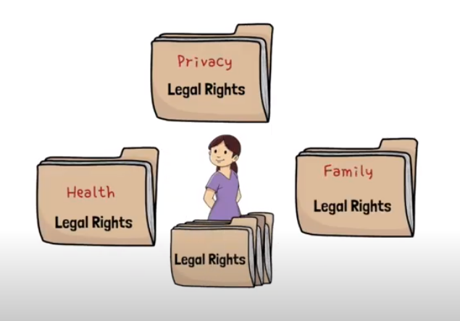
Video
We will watch a short video titled “Children and Youth as “Independent Rights Holders”
https://youtu.be/3kqyBMYzkwc (03:51)
Notes:
Show the video to participants. If there are technical issues with screen sharing for online presentations, put the link in the chat box and tell them to come back to the session after viewing it.

Slide 14
Video Discussion: Think and Share
When might a child’s or youth’s rights be affected by your work?
Think of examples in your own childhood or youth where you wish adults had listened to you better.
How do you think children and youth benefit (short or long term) from being viewed as “independent rights holders”?
Notes:
Ask participants for their initial reactions to the video. Consider using the question prompts on the slide.
Depending on the audience, consider discussing the practical implications mentioned in the video. For example, Emily Chan talked about people who may be “in the room” while you’re helping a child, and how sometimes you need more, fewer, or different people.
Who do you think you might want in the room while you’re helping a child?
Who would you NOT want in a room?
Does your answer change depending on the situation?
Should a parent always be there? Or never be there?
Good to think about who a child might want in the room, the information that child or youth can understand, and the legal rights they have (if you’re unsure, encourage the child or youth to contact Justice for Children and Youth (JFCY) for a consultation).
Note that youth rights lawyers typically meet a young person alone. They explain in simple words the child’s right to confidentiality/privilege. Then they give the child/young person a choice to have someone else in the room if they want.
You can use this discussion as an opportunity to reinforce the philosophical underpinnings of youth rights law, including:
Recognizing the benefits to young people and society of enhancing the autonomy of young people, and acknowledging the harms that can result when young people’s rights are arbitrarily constrained based on age or power dynamics with adults.
Recognizing the ongoing development and evolving maturity of young people.
It’s better for young people to gradually get additional responsibility and control over their lives as they mature, rather than everything happening at once the day they turn 18.
Acknowledging that young people are some of the most vulnerable in society. They are dependent on adults for basic necessities. Typically, we want the law to empower the most vulnerable to try to counteract the imbalance of power and to protect the vulnerable from abuse or mistreatment.
A note about criminal law. Often during discussions about youth meeting with lawyers, participants wonder whether a young person can be questioned by the police without a lawyer or parent. There are very specific laws that apply to youth criminal law, but those laws are beyond the scope of this training. In general, a young person has the right to have an adult of their choice in the room if being questioned by the police. JFCY delivers specialized training on youth criminal justice.

Slide 15
A Youth Rights Framework Questions to ask yourself when helping a client
Are a child’s or young person’s rights engaged?
What are the views and wishes of the child or young person?
What obstacles may they face?
What resources can you share or refer them to?
Notes:
This framework can act as a guide to community workers (and others) to ensure that young people’s rights are recognized and protected.
For step/question 2: The best information comes directly from the young person.
For step/question 3: Obstacles can be legal, social or personal.

Slide 16

Time for a break
Notes:
Consider a 10-minute break at this point. Tell participants exactly what time they should return or come back online.

Slide 17
Scenario 1: Leaving Home
A parent of a 16-year-old boy who is transgender tells you that the boy wants to change his legal name from Jane to John. The parent does not want him to change his name. He told his parent that he is going to move out, get his own apartment, and change his name. The parent wants to stop the boy.
Can a 16-year-old move out of their parent’s home?
Can a 16-year-old rent an apartment?
Can a 16-year-old change their legal name?
Apply the Framework:
 Youth rights engaged
 Young person’s views
 Obstacles
 Resources
 Call JFCY lawyer
Notes:
Note about using these scenarios
Read each scenario aloud, followed by the questions. Give participants a minute or so to answer the questions for themselves, or to the group, then move to the next slide with the answers.
In these scenarios, participants should start every situation by first acknowledging the Youth Rights Framework. They should get into the habit of applying this framework to every situation they face. By the end of the scenarios, applying this framework should feel almost like second nature.
While the names in the scenarios are fake, the situations are based on real clients. These are situations that Justice for Children and Youth (JFCY) lawyers deal with on a regular basis.

Slide 18
Scenario 1: Leaving Home Answers
A parent of a 16-year-old boy who is transgender tells you that the boy wants to change his legal name from Jane to John. The parent does not want him to change his name. He told his parent that he is going to move out, get his own apartment, and change his name. The parent wants to stop the boy.
Can a 16-year-old move out of their parent’s home?
Can a 16-year-old rent an apartment?
Can a 16-year-old change their legal name?
Apply the Framework:
 Youth rights engaged
 Young person’s views
 Obstacles
 Resources
 Call JFCY lawyer
Yes
Yes
Yes
Notes:
Question 1: Can a 16-year-old move out of their parent’s home? Answer — YES
In Ontario, a 16-year-old has the right to withdraw from parental control. This means they can leave the parental home and they cannot be forced to return, even by the courts. A young person does not have to do anything special to exercise this right — no forms, no court documents, nothing. Simply by leaving the home, they have withdrawn from parental control. A young person who withdraws from parental control is entitled to make their own decisions about all aspects of life, most importantly about: where they live, who they live with, and all decisions related to their education.
A young person who withdraws from parental control involuntarily is also entitled to get financial support paid directly to them from their parents or from Ontario Works. Withdrawing involuntarily means the parental home was an “unbearable place to live” — it is a much lower standard than abuse.
Question 2: Can a 16-year-old rent an apartment? Answer — YES.
The Human Rights Code prevents landlords from discriminating against young people who have withdrawn from parental control.
Question 3: Can a 16-year-old change their legal name? Answer — YES.
But they need parental consent OR a court order. If the parent does not agree, Justice for Children and Youth (JFCY) or another lawyer may be able to assist with getting a court order.

Slide 19
Scenario 2: Medical Decisions and Info
A 15-year-old girl tells you she wants birth control pills. She and her 16-year-old boyfriend are thinking about having have sex. At her last medical appointment, the doctor said she won’t give the girl the birth control pills unless the girl’s mother gives parental permission.
Is it legal for a 15-year-old and a 16-year-old to have sex?
Can a doctor give a 15-year-old girl birth control pills?
Can a doctor talk to a parent about their child’s medical information?
Apply the Framework:
 Youth rights engaged
 Young person’s views
 Obstacles
 Resources
 Call JFCY lawyer
Notes:
Note about using these scenarios
Read each scenario aloud, followed by the questions. Give participants a minute or so to answer the questions for themselves, or to the group, then move to the next slide with the answers.
In these scenarios, participants should start every situation by first acknowledging the Youth Rights Framework. They should get into the habit of applying this framework to every situation they face. By the end of the scenarios, applying this framework should feel almost like second nature.

Slide 20
Scenario 2: Medical Decisions Answers
A 15-year-old girl tells you she wants birth control pills. She and her 16-year-old boyfriend are thinking about having have sex. At her last medical appointment, the doctor said she won’t give the girl the birth control pills unless the girl’s mother gives parental permission.
Is it legal for a 15- and a 16-year-old to have sex?
Can a doctor give a 15-year-old girl birth control pills?
Can a doctor talk to a parent about their child’s medical information?
Apply the Framework:
 Youth rights engaged
 Young person’s views
 Obstacles
 Resources
 Call JFCY lawyer
Yes
Yes
No
Notes:
Question 1: Is it legal for a 15- and a 16-year-old to have sex? Answer — YES.
Sexual consent for young people is limited as follows:
12-17 years: can NOT consent with a person in a position of authority (teacher, coach, etc.)
12–13 years: can only consent with a person less than 2 years older
14–15 years: can only consent with a person less than 5 years older
16–17 years: can consent with a person any number of years older
Use the next slide (age of consent) as a refresher from the true/false game at the beginning of the workshop
Question 2: Can a doctor give a 15-year-old girl birth control pills? Answer – YES
A doctor takes medical instructions and delivers medical treatment (including prescriptions) directly to a person of any age. A person of any age can consent or refuse to consent once that person:
Understands the medical treatment involved
Understands the consequences of getting the treatment or refusing the treatment
Almost every 15-year-old will be capable of consenting to birth control on their own because almost every 15-year-old understands what that means and the consequences of taking the pill or not. The only exception might be a 15-year-old who has a serious mental disorder that affects their ability to understand this kind of information.
Question 3: Can a doctor talk to a parent about their child’s medical information? Answer – NO
A healthcare provider must get a young person’s permission before they share the young person’s health information with anyone else, including with the young person’s parent. There is no set age for this right to privacy. It’s the same as the right to refuse or consent to treatment. If the young person can understand what their health care information is, and they can understand the consequences of disclosing it, then they get to choose who the information is disclosed to.
If a healthcare provider gives a parent information without the young person’s permission, the young person can complain to the Information and Privacy Commissioner of Ontario (IPCO) and to the healthcare provider’s professional governing body.

Slide 21
Age of Consent
Sexual activity is not just sex. It includes things like kissing and touching, if done for sexual pleasure. The older person is at risk of being charged with a crime
Age | Can consent to sexual activity with someone less than… | Can consent to sexual activity with a person in authority (boss, teacher, camp counsellor, etc.)
12 or 13 | 2 years older | NO
14 or 15 | 5 years older | NO
16 or 17 | Any age older | NO
18 + | Any age older | YES
Notes:
This slide presents a table with the age of consent for four age groups. A handout is included in the Activity handouts section of the Trainer’s Guide with this same information that you can share with participants.

Slide 22
Scenario 3: Special Education
The parent of a 16-year-old says she has a meeting at the school to discuss a special education program for her son. She doesn’t want her son at the meeting, because she doesn’t want him to feel embarrassed or “dumb”. There’s a report about his reading level in his student record, but she doesn’t want her son to see the report because she thinks it makes him sound “dumb”.
Can a 16-year-old be involved in special education decisions even if their parent doesn’t approve?
Can a 16-year-old access their own student records?
Apply the Framework:
 Youth rights engaged
 Young person’s views
 Obstacles
 Resources
 Call JFCY lawyer
Notes:
Note about using these scenarios
Read each scenario aloud, followed by the questions. Give participants a minute or so to answer the questions for themselves, or to the group, then move to the next slide with the answers.
In these scenarios, participants should start every situation by first acknowledging the Youth Rights Framework. They should get into the habit of applying this framework to every situation they face. By the end of the scenarios, applying this framework should feel almost like second nature.
While the names in the scenarios are fake, the situations are based on real clients. These are situations that Justice for Children and Youth (JFCY) lawyers deal with on a regular basis.

Slide 23
Scenario 3: Special Education Answers
The parent of a 16-year old says she has a meeting at the school to discuss a special education program for her son. She doesn’t want her son at the meeting, because she doesn’t want him to feel embarrassed or “dumb”. There’s a report about his reading level in his student record, but she doesn’t want her son to see the report because she thinks it makes him sound “dumb”.
Can a 16-year-old be involved in special education decisions even if their parent doesn’t approve?
Can a 16-year-old access their own student records?
Apply the Framework:
 Youth rights engaged
 Young person’s views
 Obstacles
 Resources
 Call JFCY lawyer
Yes
Yes
Notes:
Question 1: Can a 16-year-old be involved in special education decisions even if their parent doesn’t approve? Answer — YES
The Education Act says that a student who is 16 years or older has the right to be involved in decisions about their special education needs. Students who are younger than 16 are also allowed to participate in those decisions if the parent/s consent, but they don’t have the right to participate.
Question 2: Can a 16-year-old access their own student records? Answer — YES
A student of any age always has the legal right to access their own student records. These records are known as the Ontario Student Record or “OSR”. The OSR follows a student for their entire school career until the end of high school. It has information related to special education, enrollment, discipline, medical issues, and academic performance among many other things.
Many students don’t know this, so it is useful here to emphasize the goal of the Youth Rights workshop: To recognize that youth are independent rights holders, for their own knowledge and for the community at large.

Slide 24
Scenario 4: Starting & Quitting School
A single mother of two just moved to your town in the middle of February. The school won’t allow her 5-year-old to register for school until he turns 6, even though there is a kindergarten program. Her 17-year-old was allowed to register for high school, but he hates it there. He’s been skipping school and plans to drop out.
Does a 5-year-old have the right to start school?
Can the 17-year-old be charged for skipping school?
Can the 17-year-old quit school?
Apply the Framework:
 Youth rights engaged
 Young person’s views
 Obstacles
 Resources
 Call JFCY lawyer
Notes:
Note about using these scenarios
Read each scenario aloud, followed by the questions. Give participants a minute or so to answer the questions for themselves, or to the group, then move to the next slide with the answers.
In these scenarios, participants should start every situation by first acknowledging the Youth Rights Framework. They should get into the habit of applying this framework to every situation they face. By the end of the scenarios, applying this framework should feel almost like second nature.
While the names in the scenarios are fake, the situations are based on real clients. These are situations that JFCY lawyers deal with on a regular basis.

Slide 25
Scenario 4: Starting & Quitting School Answers
A single mother of two just moved to your town in the middle of February. The school won’t allow her 5-year-old to register for school until he turns 6, even though there is a kindergarten program. Her 17-year-old was allowed to register for high school, but he hates it there. He’s been skipping school and plans to drop out.
Does a 5-year-old have the right to start school?
Can the 17-year-old be charged for skipping school?
Can the 17-year-old quit school?
Apply the Framework:
 Youth rights engaged
 Young person’s views
 Obstacles
 Resources
 Call JFCY lawyer
Yes
No
Sometimes — see next slide
Notes:
Question 1: Does a 5-year-old have the right to start school? Answer — YES
In fact, a child can start school in September of the calendar year they turn 4. A student of the correct age and in the correct school zone has the right to start school as soon as they move to that school zone, even if it is in the middle of the school year.
Question 2: Can the 17-year-old be charged for skipping school? Answer — NO
You can only be charged for skipping school if you are age 12–15. This charge is known as “truancy” under the Education Act. It is not a criminal charge but you have to go to court. It is a provincial offence. The maximum fine is $1,000 or up to 1 year of probation time or both.

Slide 26

Scenario 4: question 3 Answer
Can the 17-year-old quit school?
IF the 18th birthday is between January 1 and the last school day in June:
can quit school when turn 18
IF the 18th birthday is between the last school day in June and December 31 of the same year:
can quit on last day of school in June, even though haven’t had their 18th birthday yet
Sometimes
Notes:
Question 3: Can the 17-year-old quit school? Answer – SOMETIMES
It depends on what month they were born.
You can quit school on the day you turn 18. Also, if you turn 17 between the first day of school in September and December 31, then you can quit school at the end of that school year even, though you’re not 18 yet. You can also leave school if you graduated from high school at a younger age (e.g., graduated at age 16 because you were in an accelerated gifted program). You don’t have to stay in high school just because you’re still under 18.

Slide 27
Scenario 5: Children’s Aid and Adoption
The mother of a 7-year-old and a 12-year-old tells you that she has a chronic health problem and can no longer take care of her kids. She wants to give the kids to the Children’s Aid Society (CAS), but the kids don’t want that. She says that another option might be to let the kids’ aunt formally adopt them, but the kids don’t want that either.
Can a mother give her children to a CAS if the children don’t want to go?
Can someone adopt a child who doesn’t want to be adopted?
Apply the Framework:
 Youth rights engaged
 Young person’s views
 Obstacles
 Resources
 Call JFCY lawyer
Notes:
Note about using these scenarios
Read each scenario aloud, followed by the questions. Give participants a minute or so to answer the questions for themselves, or to the group, then move to the next slide with the answers.
In these scenarios, participants should start every situation by first acknowledging the Youth Rights Framework. They should get into the habit of applying this framework to every situation they face. By the end of the scenarios, applying this framework should feel almost like second nature.
While the names in the scenarios are fake, the situations are based on real clients. These are situations that Justice for Children and Youth (JFCY) lawyers deal with on a regular basis.

Slide 28
Scenario 5: Children’s Aid and Adoption Answers
The mother of a 7-year-old and a 12-year-old tells you that she has a chronic health problem and can no longer take care of her kids. She wants to give the kids to the Children’s Aid Society (CAS), but the kids don’t want that. She says that another option might be to let the kids’ aunt formally adopt them, but the kids don’t want that either.
Can a mother give her children to a CAS if the children don’t want to go?
Can someone adopt a child who doesn’t want to be adopted?
Apply the Framework:
 Youth rights engaged
 Young person’s views
 Obstacles
 Resources
 Call JFCY lawyer
Yes, if younger than 12
No, if 7 or older
Notes:
Question 1: Can a mother give her children to a Children’s Aid Society (CAS) if they don’t want to go? Answer — YES, if under age 12
A parent can temporarily have a CAS take care of a child who is under 12 years old. But if the child is 12 or older, the parent can’t do this unless the child agrees.
Question 2: Can someone adopt a child who doesn’t want to be adopted? Answer — NO, if the child is at least 7
A child cannot be adopted against their will if they are 7 years or older. The rationale for this is straightforward: adoptions that break down create serious, long-term negative consequences for children. An adoption is more likely to break down if the child is adopted against their will; giving the child the power to veto the adoption helps to avoid the risk of the adoption breaking down.

Slide 29
Self-Reflection Questions
In my work with adults, do I intentionally consider the rights of affected children?
In my work, do I assume adults make decisions for their child, or do I meaningfully consider the child’s rights and preferences?
At work, do I have tools, resources, and information about children and youth rights that I can share with clients?
What will I do if my personal beliefs conflict with the way that a child wants to exercise their legal rights?
What will I do if another adult is preventing a child from exercising their rights?
Notes:
Ask participants to spend 2 minutes thinking about their personal answers to the questions, or to select one question to focus on.
Invite participants to share with the group an answer they feel comfortable sharing.
Engage with what participants have shared. Try to bring comments back to the underpinning philosophies of youth rights and the intention to interact with young people as independent rights holders.

Slide 30
What can community workers do?
Young people and children:
Don’t have to wait until they’re 18 to exercise their legal rights
Have legal rights in all aspects of life, not just when they’re victims or when they’re in trouble with police
Can talk to a youth rights lawyer for free.
Justice for Children and Youth (JFCY) lawyers can help youth up to age 17, or homeless youth from 18-25.
Telephone: 416-920-1633, Ontario Toll Free: 1-866-999-JFCY (5329)
Notes:
Repeat the key “takeaway” concepts that participants should remember from the training that they can apply to their work. This includes working directly with children and youth, and also indirectly through work with adults where children’s rights are also affected.
Reinforce the idea of legal rights being granted to people at different ages and at different stages of development, not just at age 18.
Remind participants that the aim was not for them to become experts in youth rights, but rather to increase their understanding, and to appreciate the resources that are available (see next slide).

Slide 31
Resources
Justice for Children and Youth (JFCY): Legal Rights Wiki
Steps to Justice, Community Legal Education Ontario (CLEO):
Education
Youth Criminal Justice
Ontario Justice Education Network (OJEN): Training in justice education for teachers, youth and community workers
Notes:
Share your screen and walk participants through the Justice for Children and Youth (JFCY) ‘wiki’ at *https://jfcy.org/en/you-have-rights/. Show the wide range of resources available.
Generally, if you’re looking for an immediate legal answer, go to the JFCY wiki page. If you want to print out something to give to a client, go to the JFCY ‘Publications’ page. Both pages include the same information in different formats.
Explain CLEO’s Steps to Justice website, which has legal information, tips and resources on many legal topics. *https://stepstojustice.ca
Share your screen and demonstrate how to navigate to the education (*https://stepstojustice.ca/legal-topic/education) and youth criminal justice questions (*https://stepstojustice.ca/legal-topic/criminal-law/youth-criminal-justice).
Explain that OJEN has many resources for teachers and youth, including training workshops. *http://ojen.ca/en/training
*NOTE: Website URLs and hyperlinks in PowerPoint’s notes are not ‘live’. You will have to cut and paste links into your browser. (The links are live on the slide.)

Slide 32

We want your feedback!
Notes:
Respond to any outstanding questions
Distribute evaluation forms that participants can fill out and email to you if training is online, or complete and return to you if training is in person
Ask participants if they want to share any feedback about the training

Slide 33
Thank you!
Include your clinic information and your contact email
We are grateful for the expertise and assistance of Justice for Children and Youth (JFCY) in developing this workshop.
Notes:
Thank the group for their participation.
Include your CLINIC information and your contact email on this slide. Add any details about your clinic’s intake process that you wish to share.
We are grateful for the expertise and assistance of Justice for Children and Youth (JFCY) in developing this workshop.

Slide 34
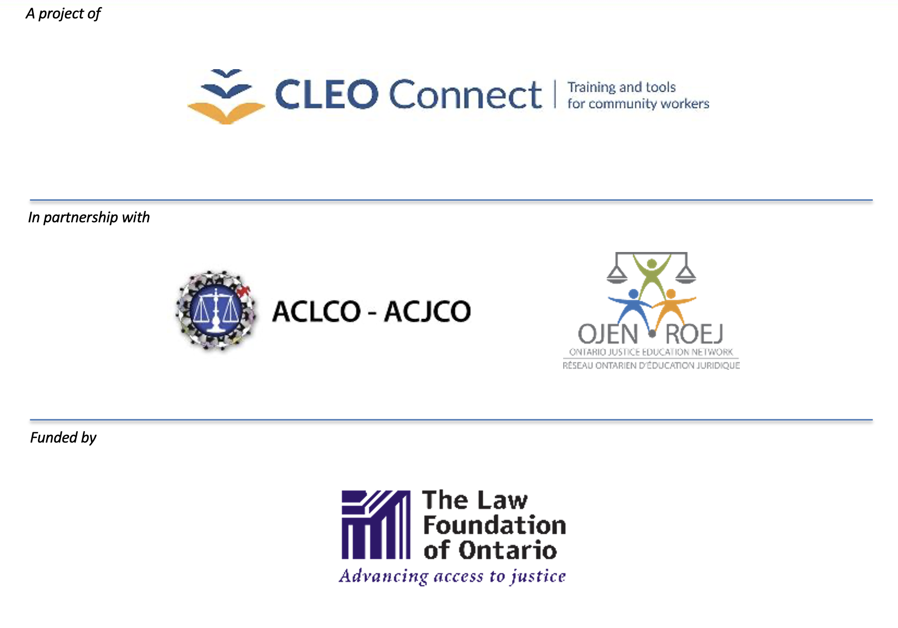
Notes:
Highlight funding from The Law Foundation of Ontario — and this training is part of a series developed by CLEO in collaboration with the ACLCO (Association of Community Legal Clinics of Ontario) and OJEN (Ontario Justice Education Network) and a clinic advisory group from across the province.
Ask participants to suggest other topics they would like to learn about.

